Slide 1
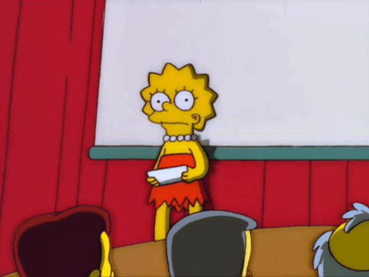
Midterm Presentation

Slide 2
Who? (姓名/職業/頭銜)
Where? (國家/城市/地點名稱)
Look like? (描述長相)
What’s new? (趣聞)
When? (何時發生)

Slide 3
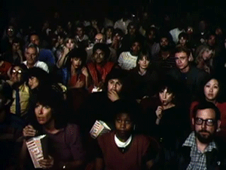
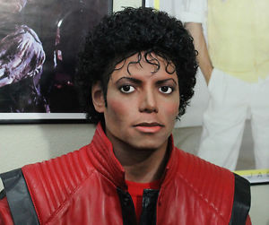
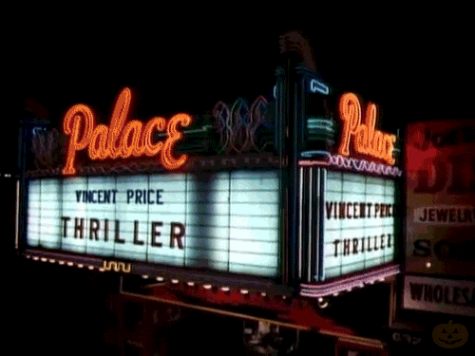
Michael Jackson
Thriller- scene of the movie theater

Slide 4
Who? He’s a famous singer “Michael Jackson”.
Where? He’s from the USA. He’s at the movie theater.
Look like? He has short, curly, black hair, big black eyes, a big pointy nose, and a glamour mouth.
What’s new? The picture is from the MV “Thriller”. Michael Jackson can do zombie dance so well.
When? I can hear this song on Halloween every year.

Slide 5
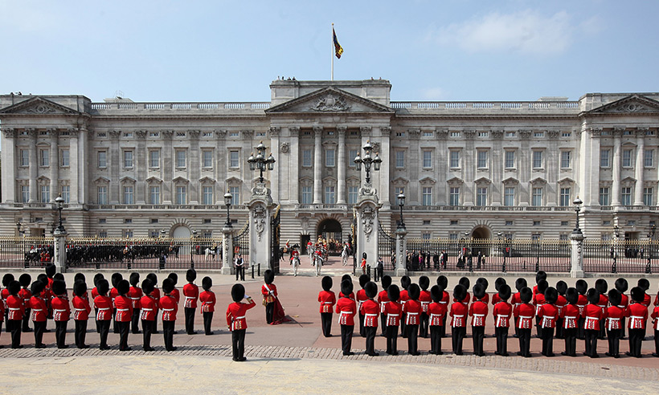
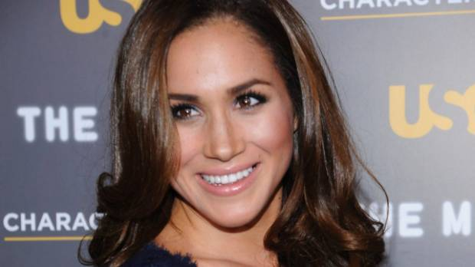
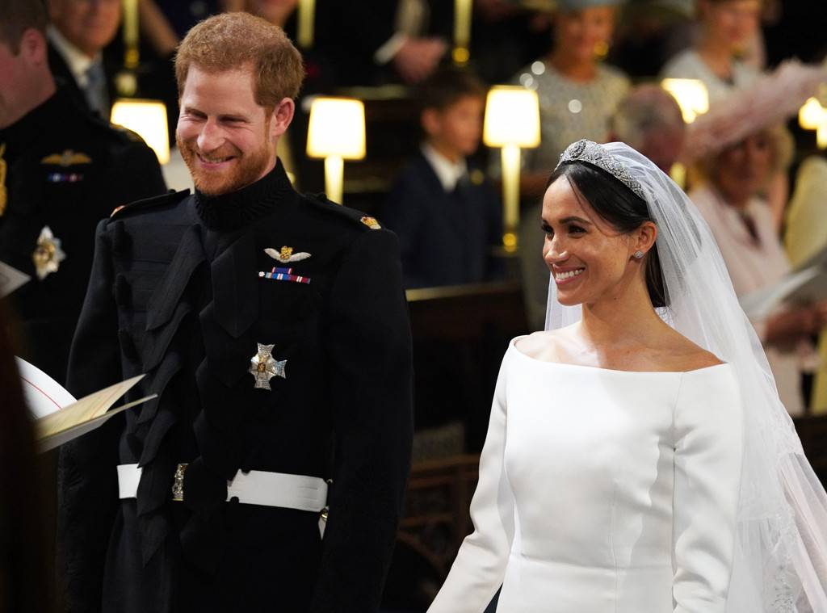
Buckingham Palace白金漢宮
Prince Harry & Princess Meghan

Slide 6
Who? They are “Prince Harry & Princess Meghan”.
Where? They’re from the UK. They’re at Buckingham Palace.
Look like? Prince Harry has short, curly, brown hair, and a beard. Princess Meghan long, wavy, brown hair, brown eyes, and a sexy big mouth.
What’s new? British royal family lives in Buckingham Palace.
When? The official start time for the Changing of the Guard at Buckingham Palace is 11:00.

Slide 7
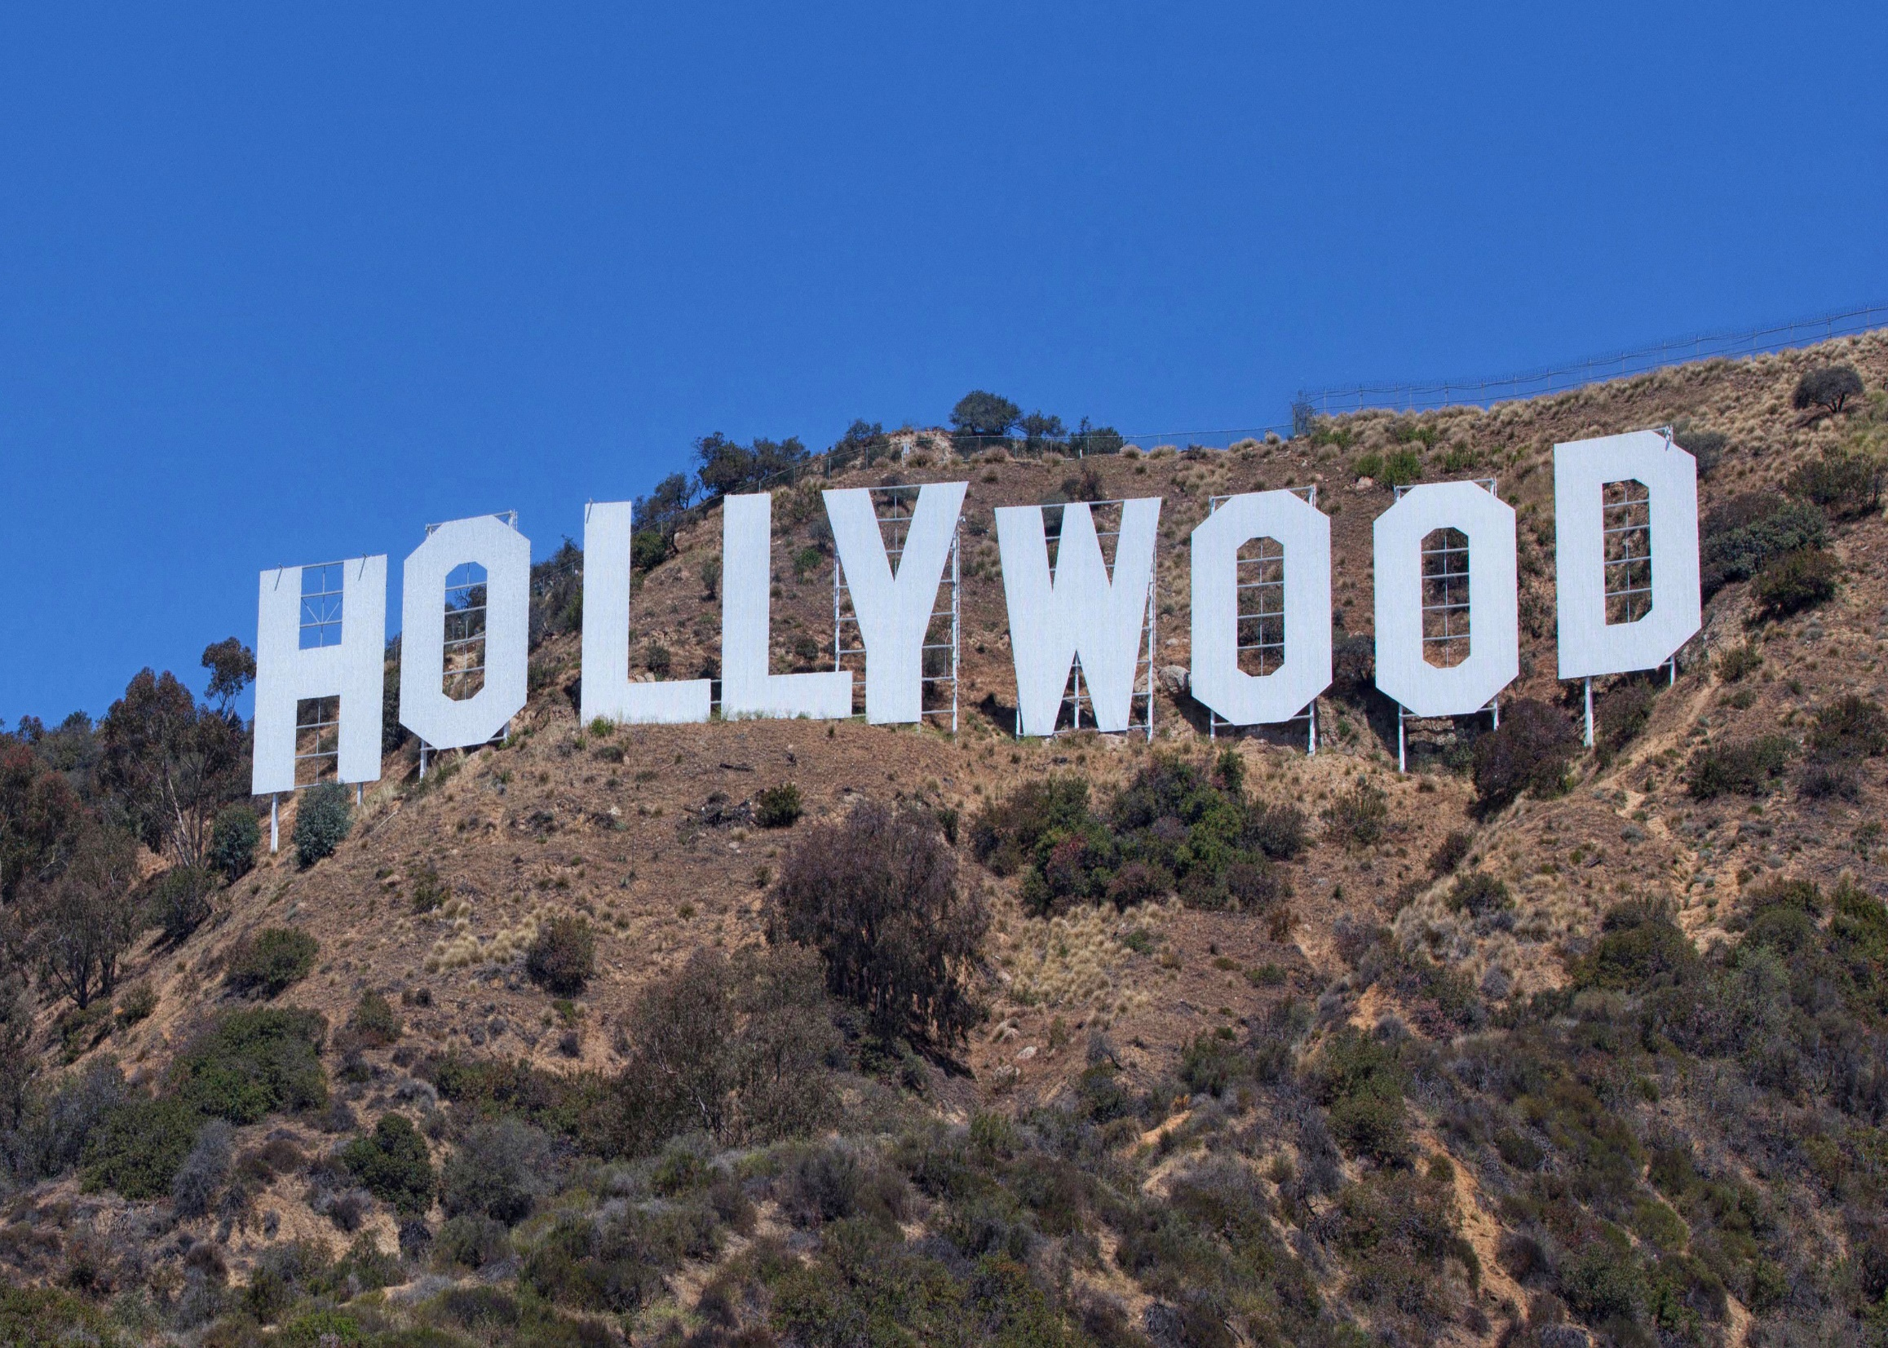
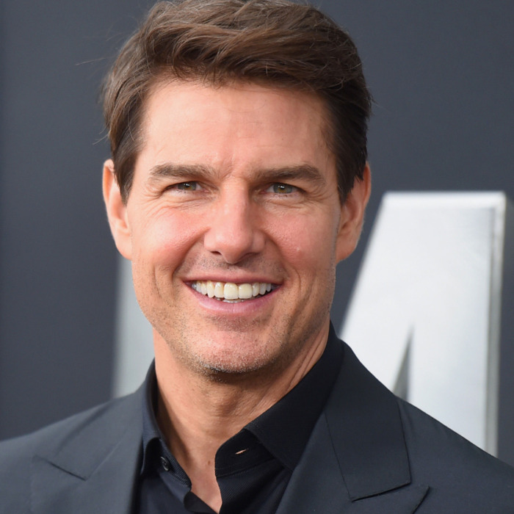
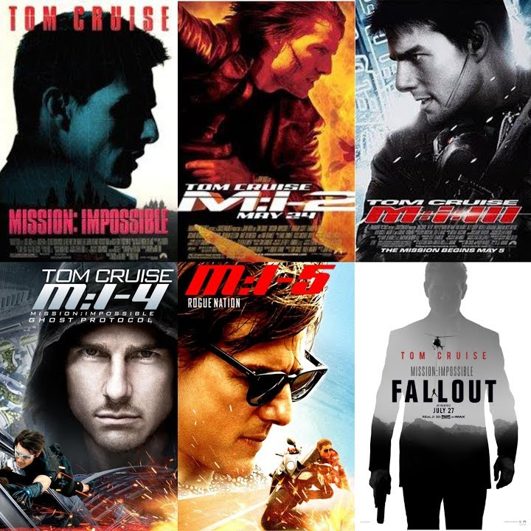
Hollywood Sign好萊塢標誌
Tom Cruise

Slide 8
Who? He’s an amazing Hollywood actor “Tom Cruise”.
Where? He’s from the USA. Hollywood Sign is in LA, California.
Look like? He has short, brown hair, green eyes, a pointy nose, and a big mouth.
What’s new? Mission Impossible series are all incredible. Tom Cruise did lots of difficult tasks by himself.
When? The 6th movie “Fallout” was released in 2018 summer vacation.

Slide 9
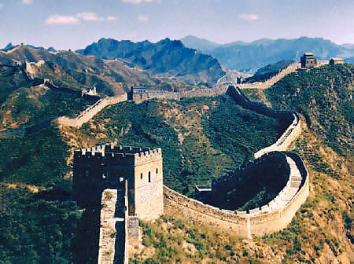
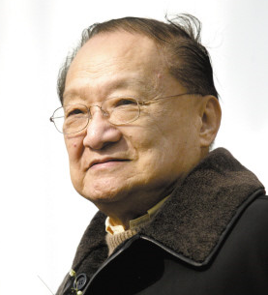
The Great Wall of China萬里長城
Jin Yong金庸

Slide 10
Who? He’s a great writer “Jin Yong”.
Where? He’s from China. The Great Wall of China is a well-known landmark.
Look like? He has a bold head, smiling eyes, big ears , a round nose, and thin lips.
What’s new? Jin Yong wrote many classic chivalry novels. “The Smiling, Proud Wanderer” is my favorite story.
When? It was first released in Hong Kong in the newspaper Ming Pao from 1967 to 1969.

Slide 11
Deadline: 11/9 (Fri)
Format: 1. 8K paper for one side
2. Both picture (paste or draw) and words.
3. Try your best to describe every question.
※The masterpiece that be pasted on the board can get 100 points.

