Slide 1
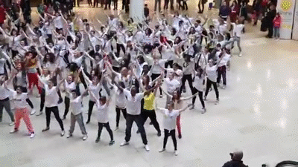
Flash mob快閃表演

Slide 2
How to do?
相約在指定時間和地點集合，一起做出特定的動作（例如拍手掌、喊口號等引人注意的動作），又在短時間內若無其事般消失退場。

Slide 3
What does the fox say? + PPAP

Slide 5
Dog goes "woof".

Slide 6
Cat goes "meow".

Slide 7
Bird goes "tweet".

Slide 8
And mouse goes "squeak".

Slide 9
Cow goes "moo".

Slide 10
Frog goes "croak".

Slide 11
And the elephant goes "toot".

Slide 12
Ducks say "quack".

Slide 13
And fish go "blub".

Slide 14
And the seal goes "ow ow ow".

Slide 15
But there's one sound

Slide 16
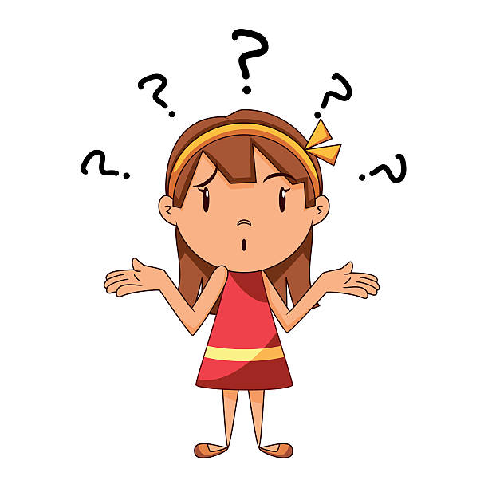
That no one knows

Slide 17
What does the fox say?

Slide 18
Ring-ding-ding-ding-dingeringeding!*3 What the fox say?

Slide 19
Wa-pa-pa-pa-pa-pa-pow!*3 What the fox say?

Slide 20
Hatee-hatee-hatee-ho!*3 What the fox say?

Slide 21
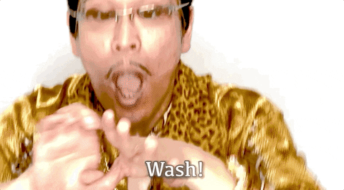

Slide 22
I have a hand.
I have a soap.
Huh! Wash your hands.

Slide 23
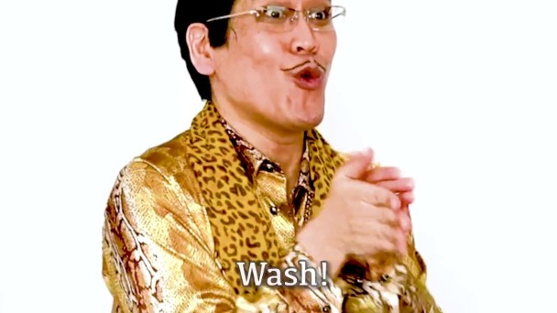
You have to wash, wash, wash
And wash, wash, wash
Wash, wash, wash
And wash, wash, wash,

Slide 24
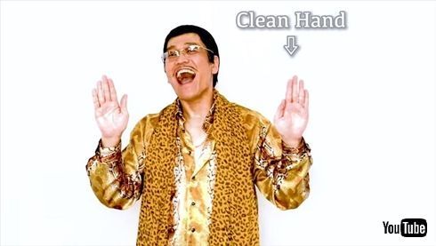
Clean hand, clean hand,
clean hands
Pray for People And Peace

