Slide 1
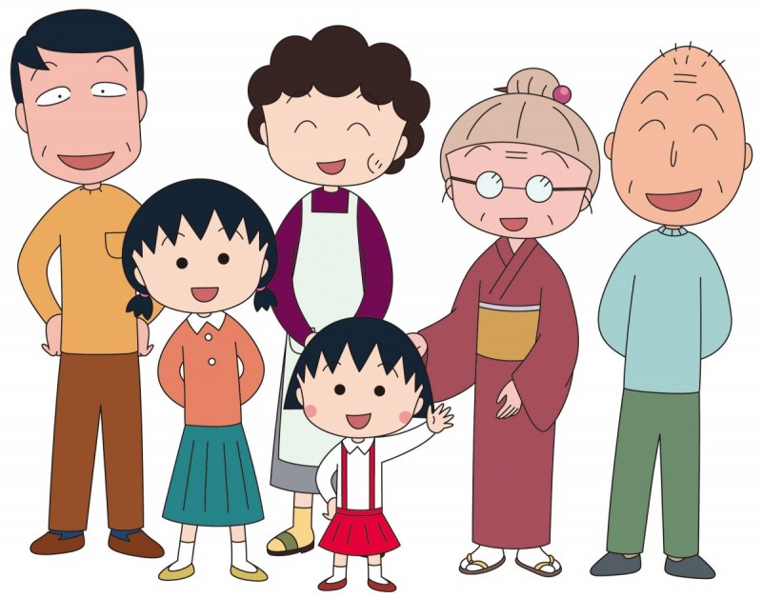
Who’s she?
She’s my grandma.

Slide 2
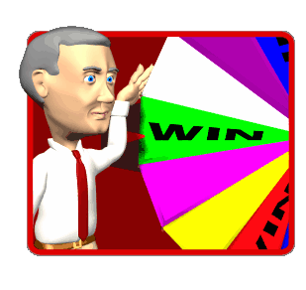
Get 10 stamps
Choose 1 thing from Evolution Zone(進化區).
Choose 1thing from Movement Zone(招式區).
Choose what( ) you want.

Slide 4
Let me introduce my family!

Slide 5
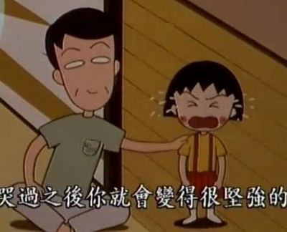
He’s my father.

Slide 6
father
dad、daddy

Slide 7
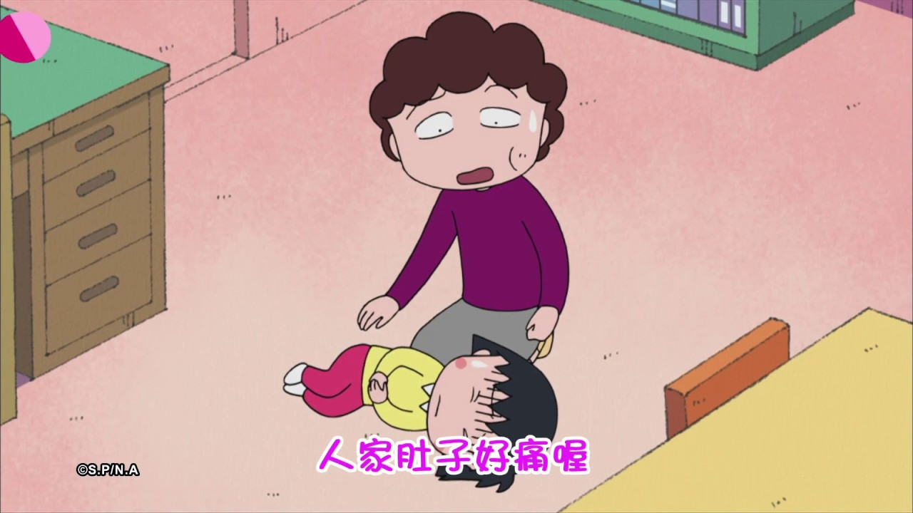
She’s my mother.

Slide 8
mother
mom、mommy

Slide 9
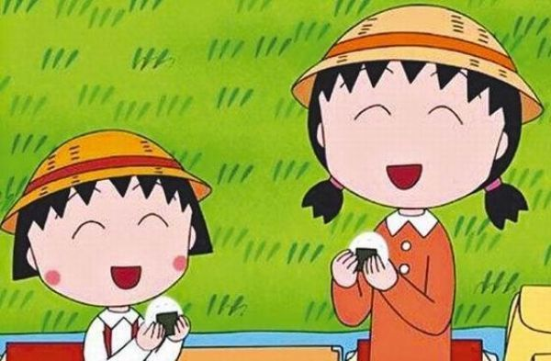
She’s my sister.

Slide 10
sister

Slide 11
He’s my grandpa.

Slide 12
grandpa
grandfather

Slide 13
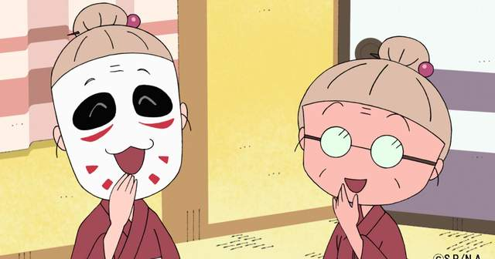
She’s my grandma.

Slide 14
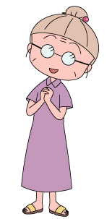
grandma
grandmother

Slide 15
mother
3
grandma
2
5
sister
father
grandpa
me
1
4

Slide 17
He’s my brother.

Slide 18
brother

Slide 19
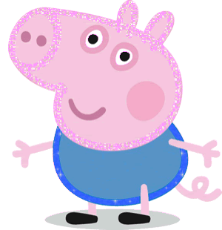
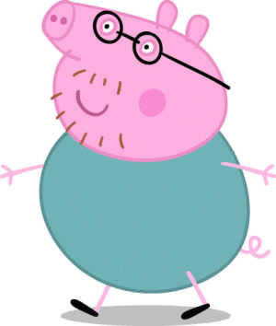
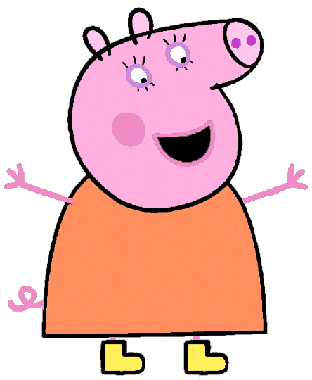
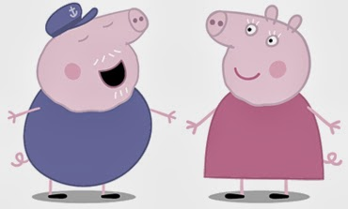
brother
3
1
grandpa
5
father
me
4
2
grandma
mother

Slide 20
