Slide 1
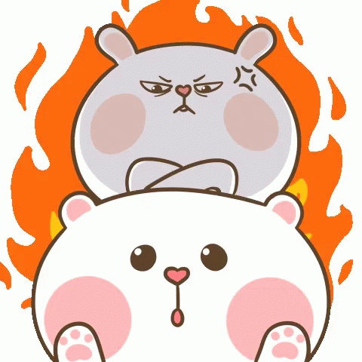
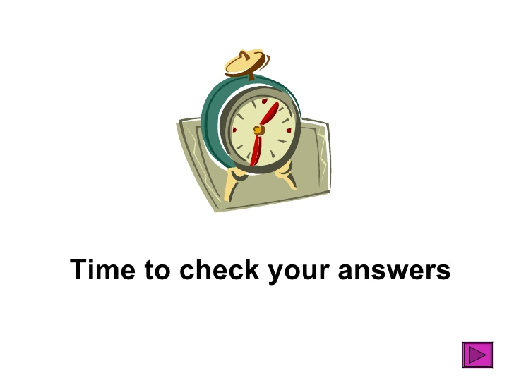
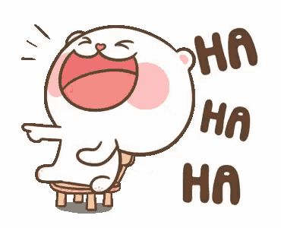
anger
delight
sorrow
happiness

Slide 2
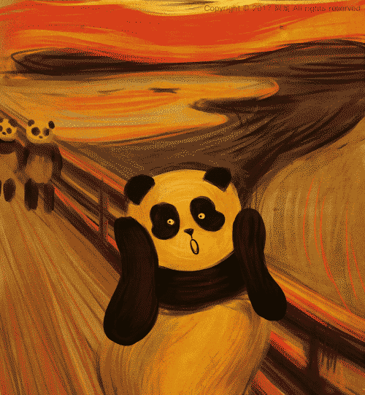

Slide 4
Chaplin likes to wear a “hat”. He used the “pine” to make his “cane”. He had no “time” to fly a “kite”.

Slide 5
a
a e
i
e
i e
e e

Slide 6
2
What time is it? Summer time! It’s on vacation.
Look! It’s Big Ben. We’re in London now.
It’s one thirty. Time to travel.
No! It’s time to eat. We need some fish & chips.

Slide 7
1
123 Eyes on me. 12 Eyes on you.
It’s eleven o’clock. Time for English class. Who can tell me why did the girl sit on the clock?
Teacher mememememe! Because she felt bored.
You’re wrong! She wanted to be “ON TIME”.

Slide 8
2
I played Switch all night. (yawn) I’m really tired.
Go to sleep. Go to sleep. Lalalalalalala.
Waiiit! Where’s your homework?
(snoring)

Slide 9
6
4
2
It’s 07:30 AM.
Time for breakfast.
It’s twelve o’clock.
Time for lunch.
Rise and shine.
3
5
1
Take a rest.
Hooray!
Come and join us.

Slide 10
X
It’s four twenty-five.
Mr. Bean is singing a song.

Slide 11
O
It’s eight thirty.
Mr. Bean is cooking noodles.

Slide 12
X
It’s twelve o’clock.
Mr. Bean is taking a shower.

Slide 13
3
Hey, Stanley. How’s the weather? It’s cloudy.
What’s that? It’s a clock.
What time is it?

Slide 14
1
Just stay home. Just stay home.
All your plans are now no more.
Oh boy! What are you doing?

Slide 15
3
(sniffing) Hmm…smells nice.
I’m so hungry.
Me, too. What’s for dinner?
Where’s Mom?
Just a second, honey. (chopping)
What’s my mom doing?

Slide 17
or
if
iv
ir
u n
rit

Slide 18
I am
They’re
can’t
Do not
He’s

Slide 19
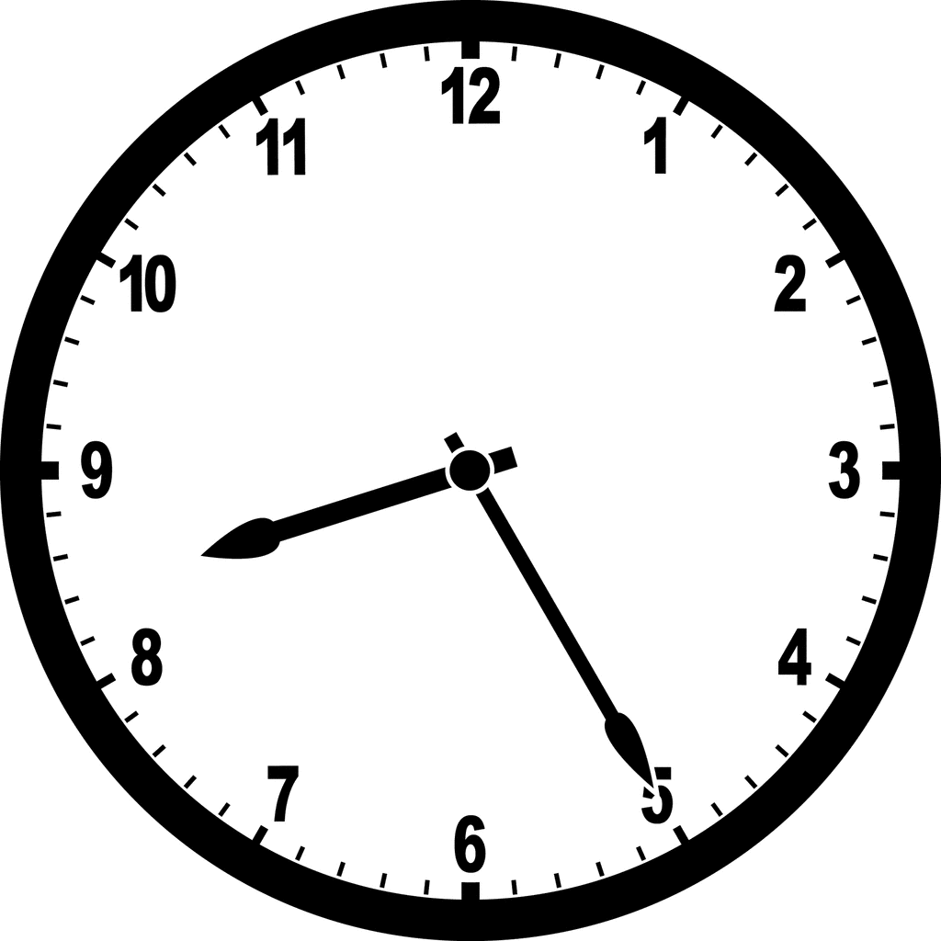
字母要寫在正確的格線上

Slide 20
閱讀測驗小技巧:
先瀏覽過題目一遍
圈出關鍵字
再細看文章找答案

Slide 22
T
F
playing Quidditch
T
F
salmon sushi
F
08:00

Slide 23
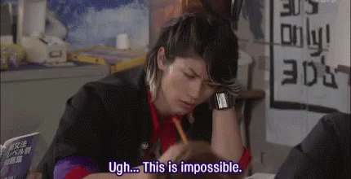
Making corrections is very important!

Slide 24
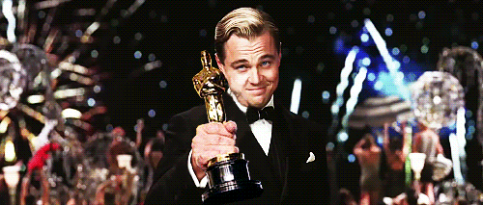
100: 5 stamps
95~99: 4 stamps
90~94: 3 stamps
85~89: 2 stamps
80~84: 1 stamps
Wonderful
Very good

