Slide 1
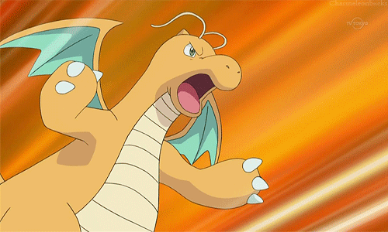
What can Dragonite do?

Slide 2
【第十週英語作業】
寫:紫色Focus讀寫練習本Unit2全。
【英語期中多元評量】
上台表演自己組別決定的內容，
回家多聽CD複習，把內容背起來效果更棒!

Slide 3
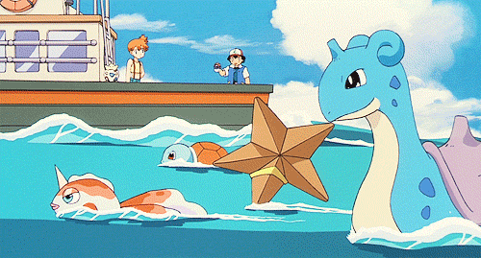
About mid-term exam

Slide 4
Choice 1:
Starter Unit 課文 +
Work It Out +
【am/an】韻文

Slide 5
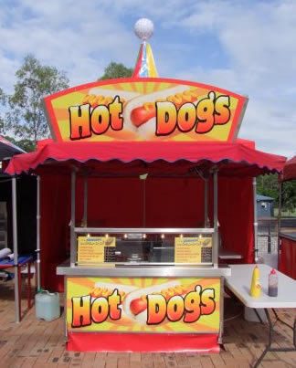



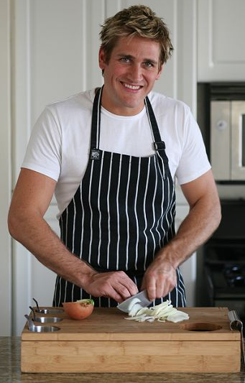
Look! That’s my brother, Ted.
Your brother?

Slide 6



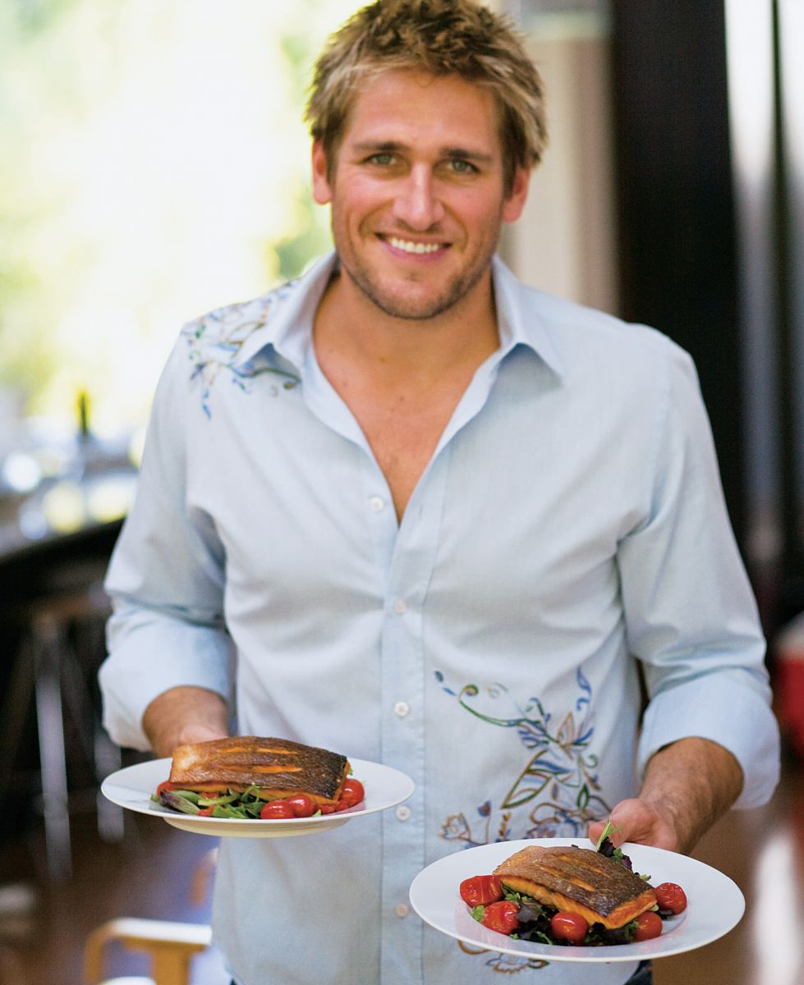
Hey, Ted. This is my friend, Niki.
Nice to meet you.
Nice to meet you, too.

Slide 7


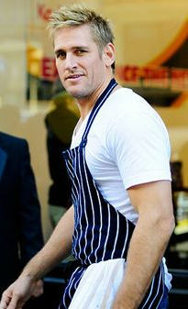
Is your brother a cook?
Yes, he is.

Slide 8
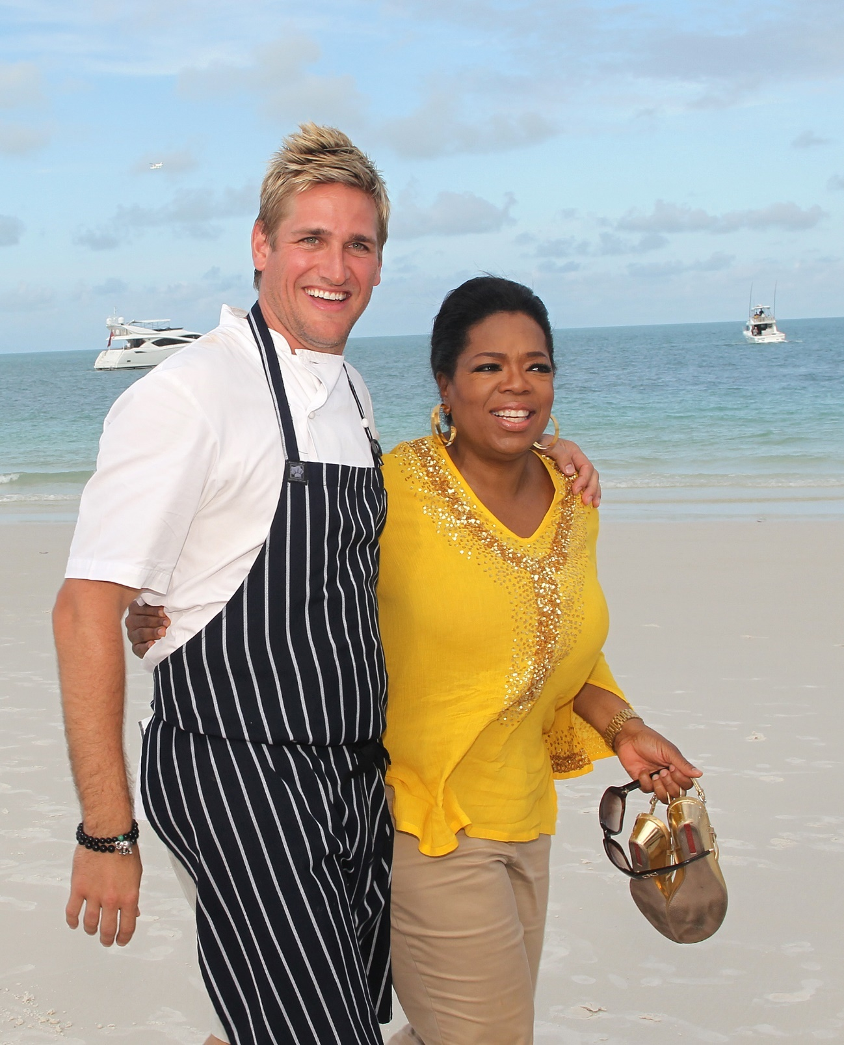
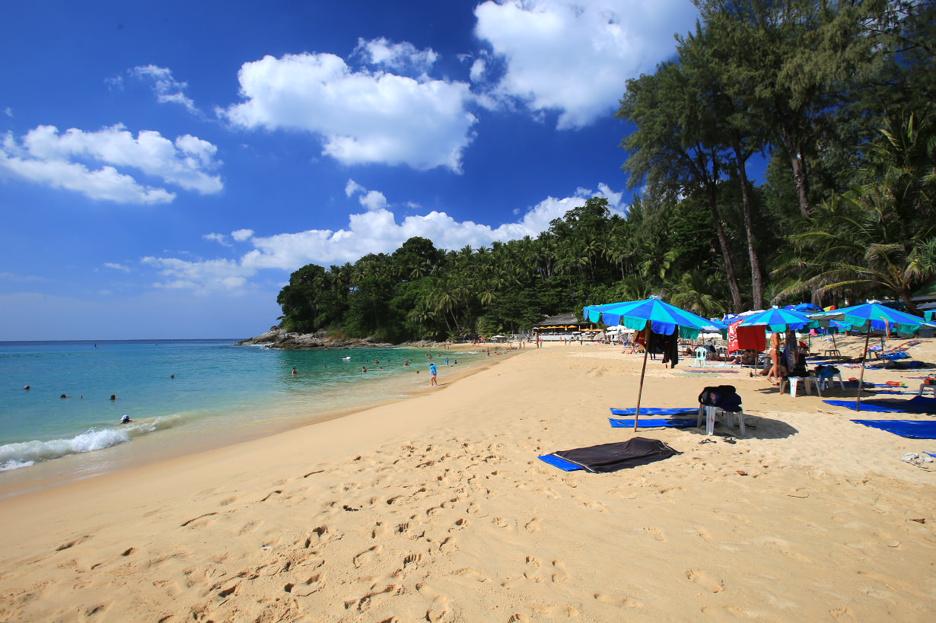


Wow! Your brother is tall.

Slide 9
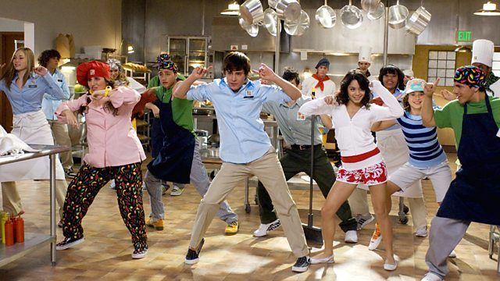
Work it out

Slide 10

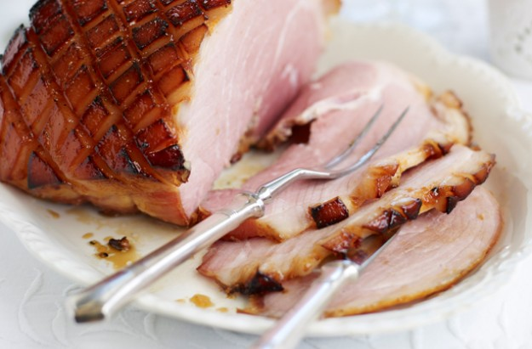
Sam likes ham.

Slide 11
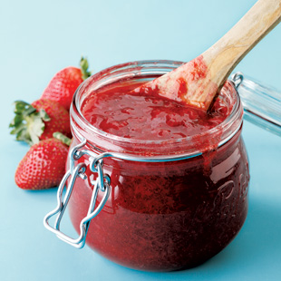
Sam likes jam.

Slide 12

Sam likes ham
and jam.

Slide 13

This is a man.

Slide 14
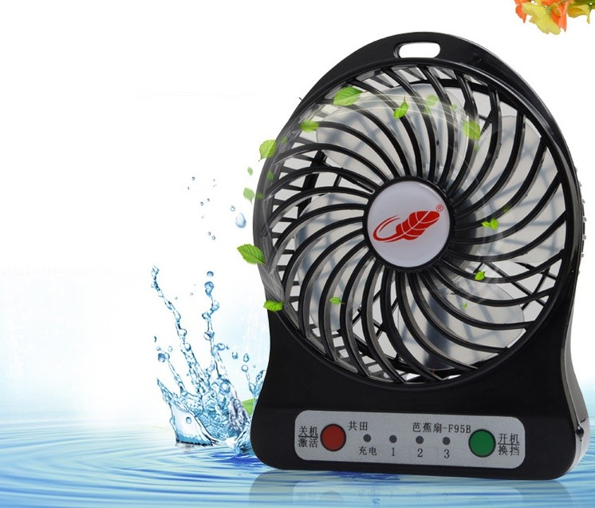

He has a fan.

Slide 15
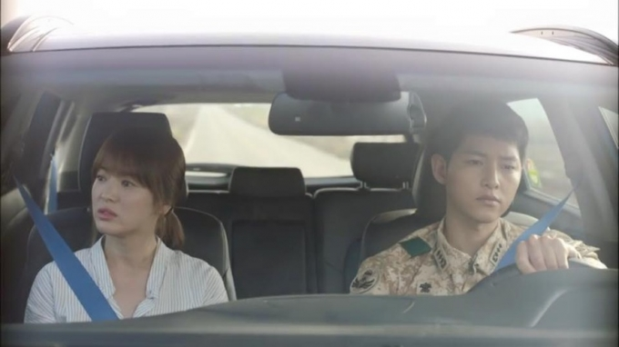
The man has a fan in his van.

Slide 16
Choice 2:
Unit 1課文 +
Try +
【en/ell】韻文

Slide 17
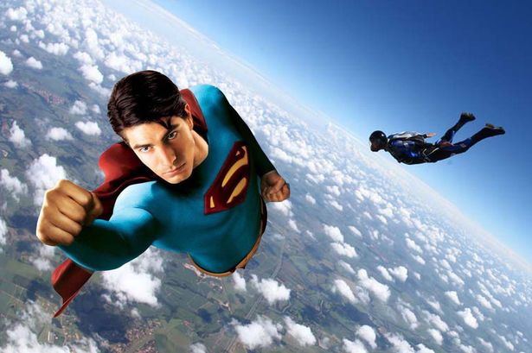
Niki: Can you fly?
Dino: Yes, I can. Look!
Niki: Cool!
Superman超人

Slide 18

Owen: Dino! Can you jump?(Boing)
Dino: No, I can’t. Can you?
Owen: (Bang) Ouch!
Dino: Oh, no!
box horse跳箱

Slide 19
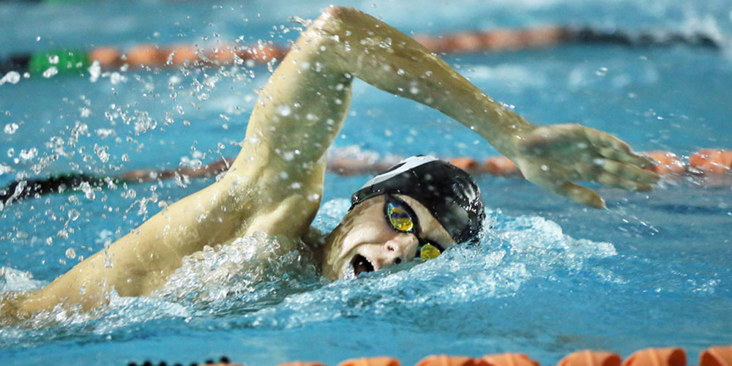
Irene: Can you swim, Dino?
Dino: Of course. Look at me.
Irene: Good job!
free style自由式

Slide 20
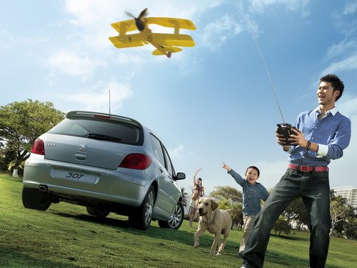
Danny: Can you play, Dino?
Dino: I don’t know!
Help! Help!
remote control aircraft遙控飛機

Slide 21

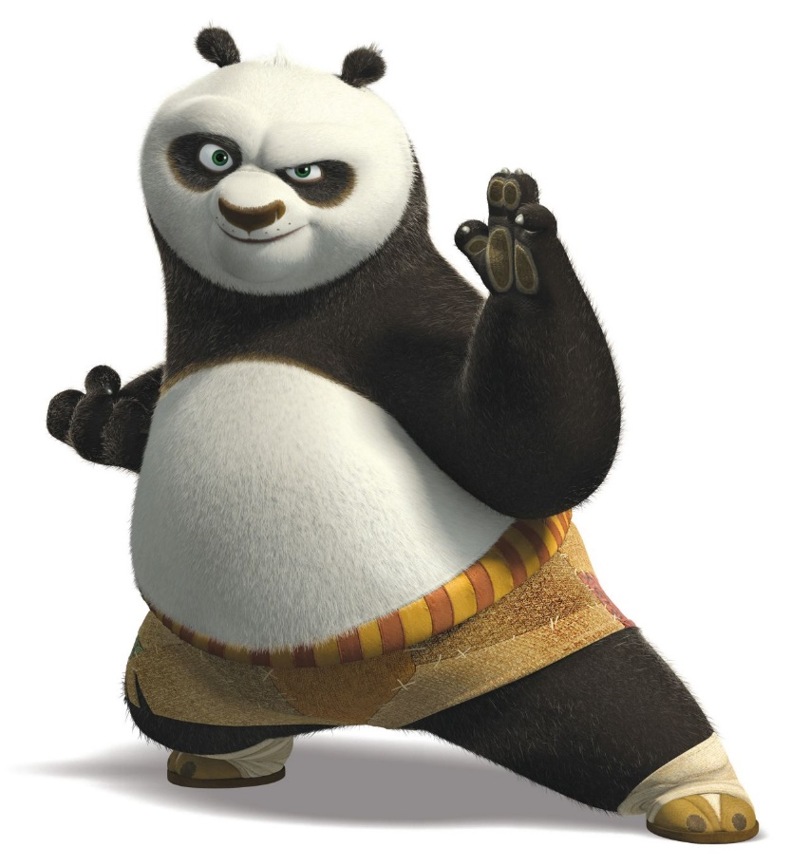
Oh Try try try try
Just do what is right
You'll fly so high
Let go of the brakes
Be who you are
Be yourself 'cause your power is on
When you believe in what you've got
You know you're perfect just be who you are

Slide 22
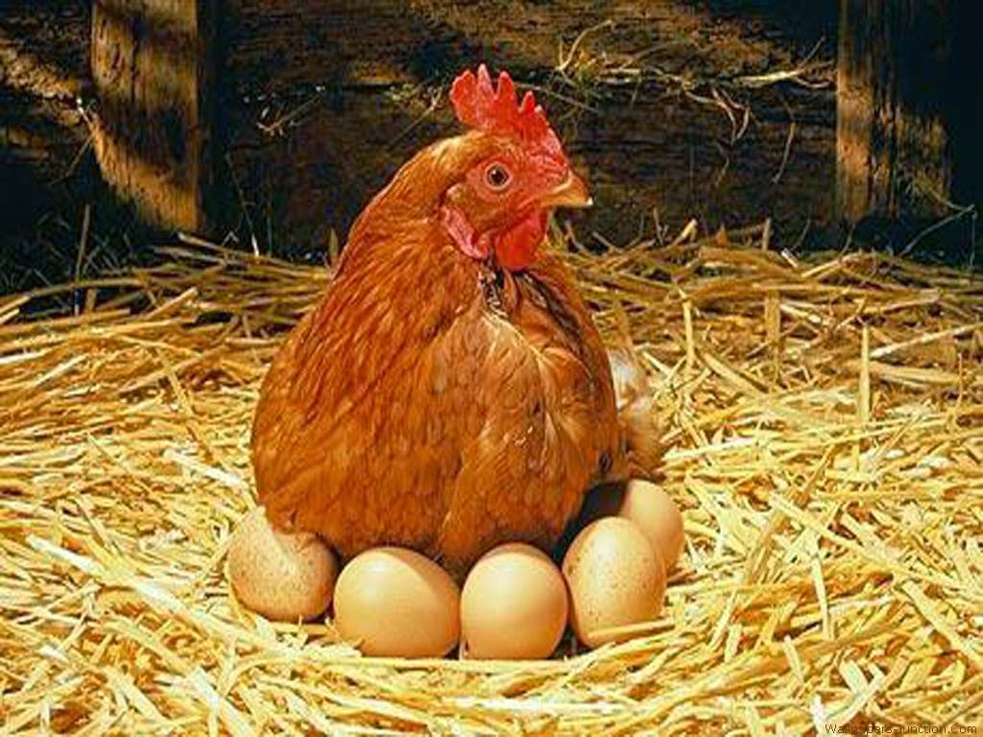
This is a hen.

Slide 23
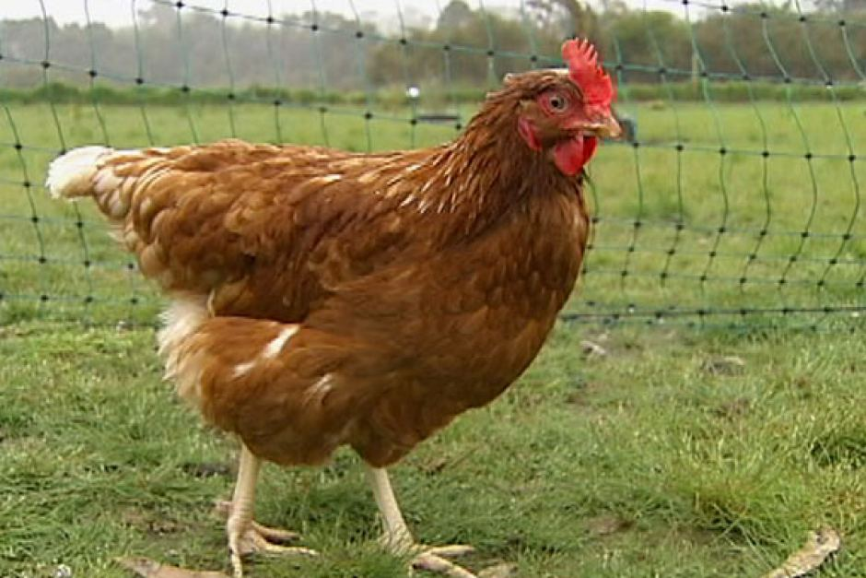

The hen has a pen.

Slide 24
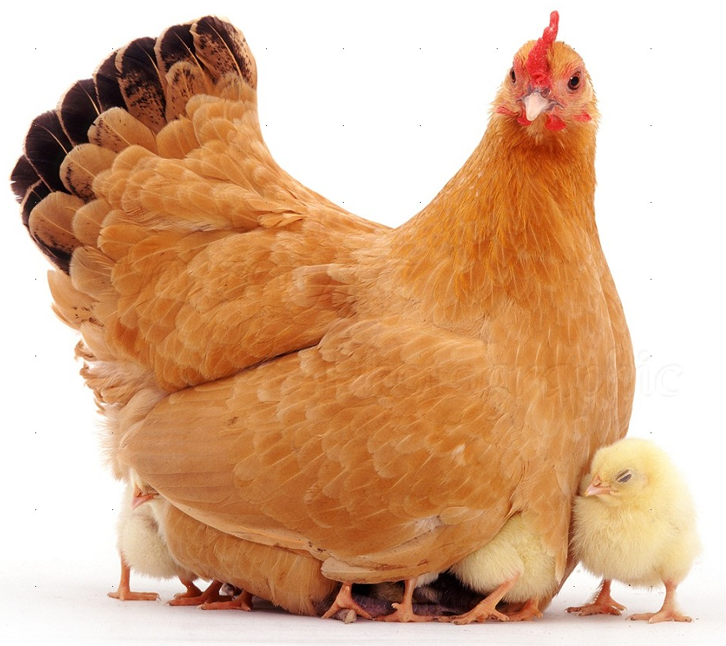
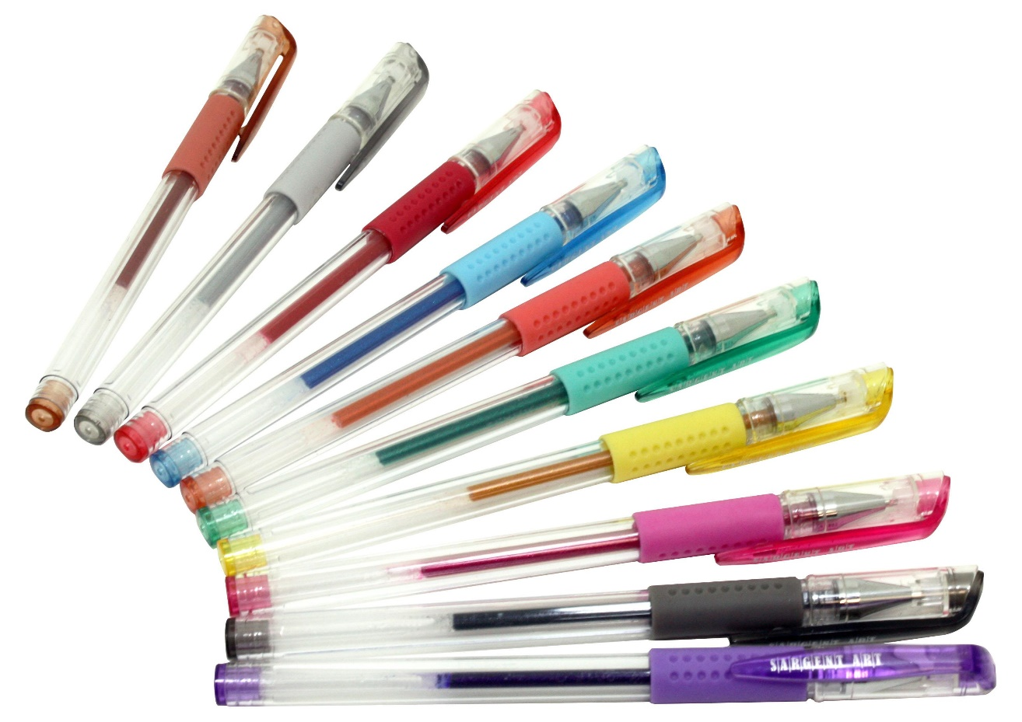
Oh! The hen has ten pens.

Slide 25


He has a bell.

Slide 26

He can yell.

Slide 27
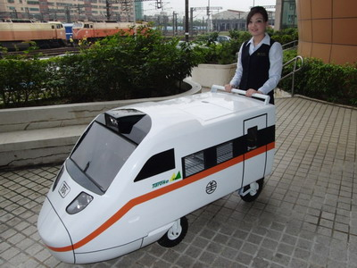


He can yell and sell the bell.

Slide 28
Choice 3:
Unit 2課文 +
I Can… +
【ip/it】韻文

Slide 29
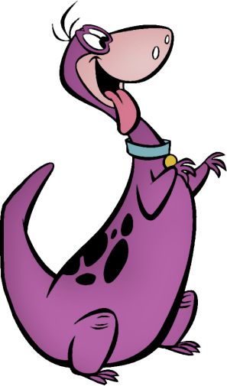
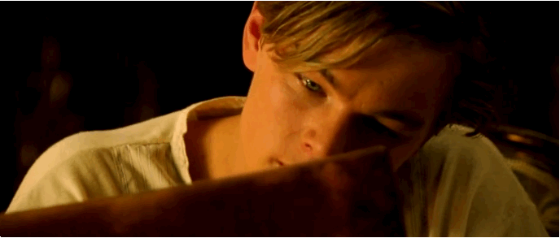
Wow! Danny, you can draw.
Yes, I can.

Slide 30
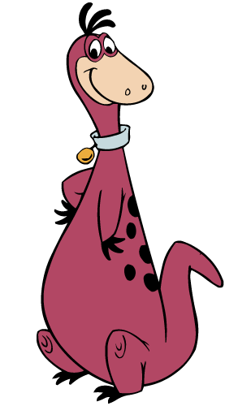

And you can write, Irene.
That’s right.

Slide 31



What can you do,Dino?
I can read.
Once upon a time…

Slide 32
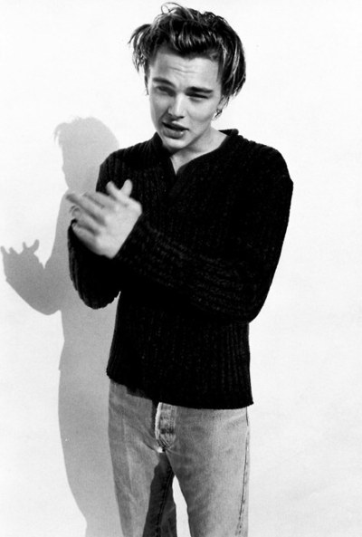
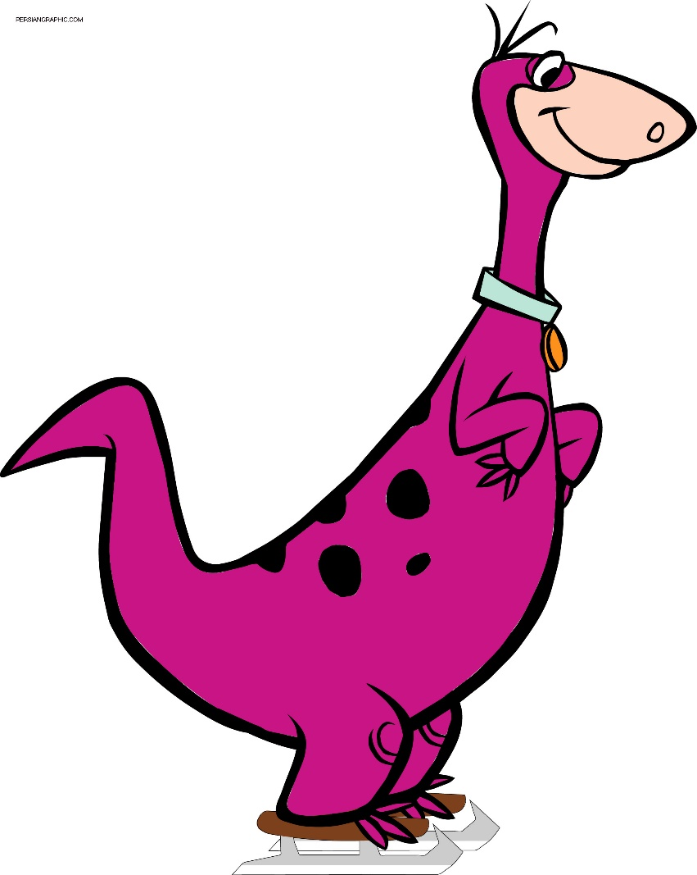
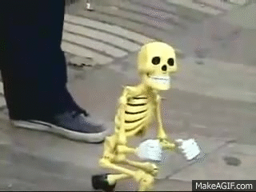
Look at my puppet.
He can walk.

Slide 33

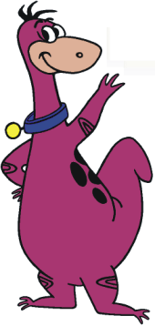
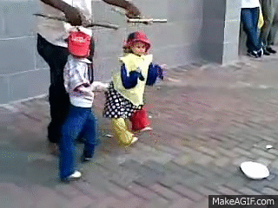
Look! She can dance.
Cool!

Slide 34
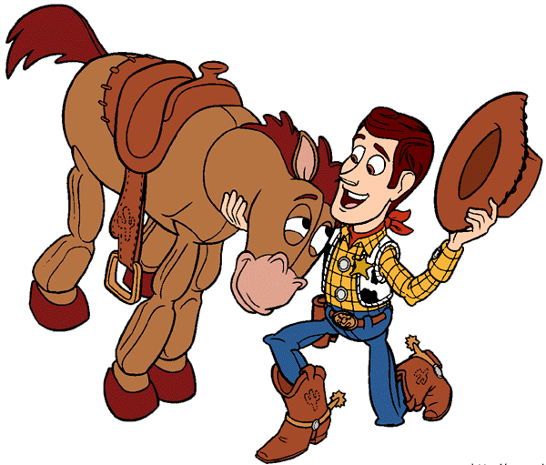
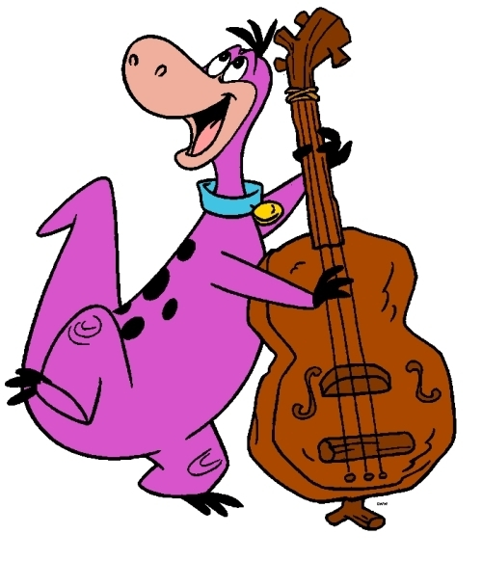
Look at my horse.
What can it do?
It can run.

Slide 35
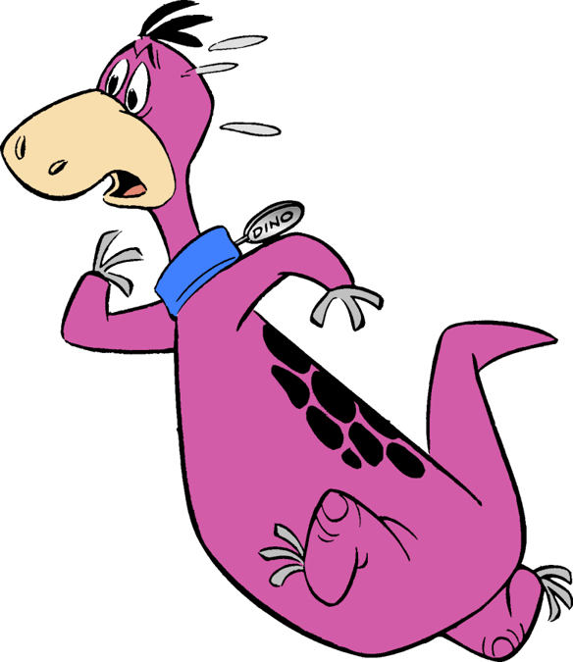
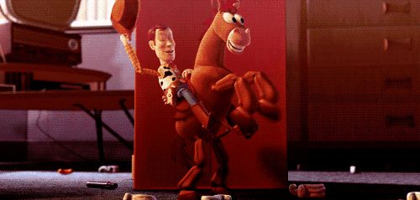
Oh, no!!!
Watch out!

Slide 36
I Can
walk
draw
read
roller-skate
I can fly,
I'm proud that I can fly
To give the best of mine
The heaven in the sky
cook
run
roller-skate
read
walk
draw
run
cook

Slide 37
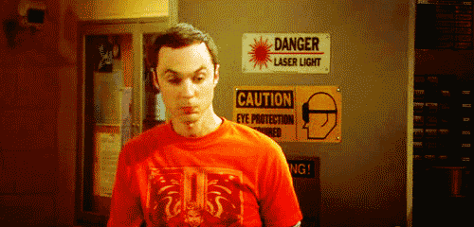
Zip your lip.

Slide 38
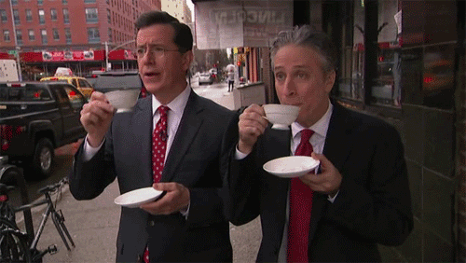
Sip your tea.

Slide 39
Zip your lip and sip your tea.

Slide 40

Don’t quit.

Slide 41
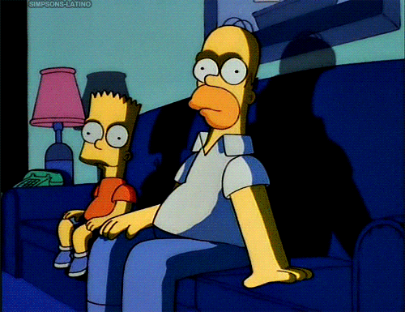
Sit for a bit.

Slide 42
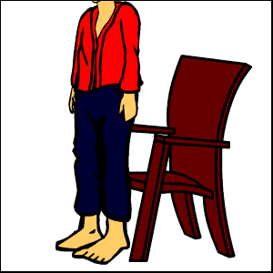
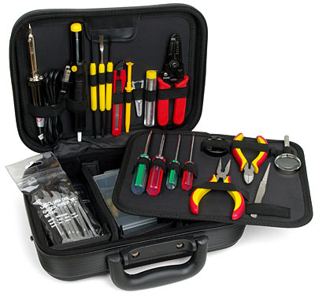
You can sit by the kit.

Slide 43
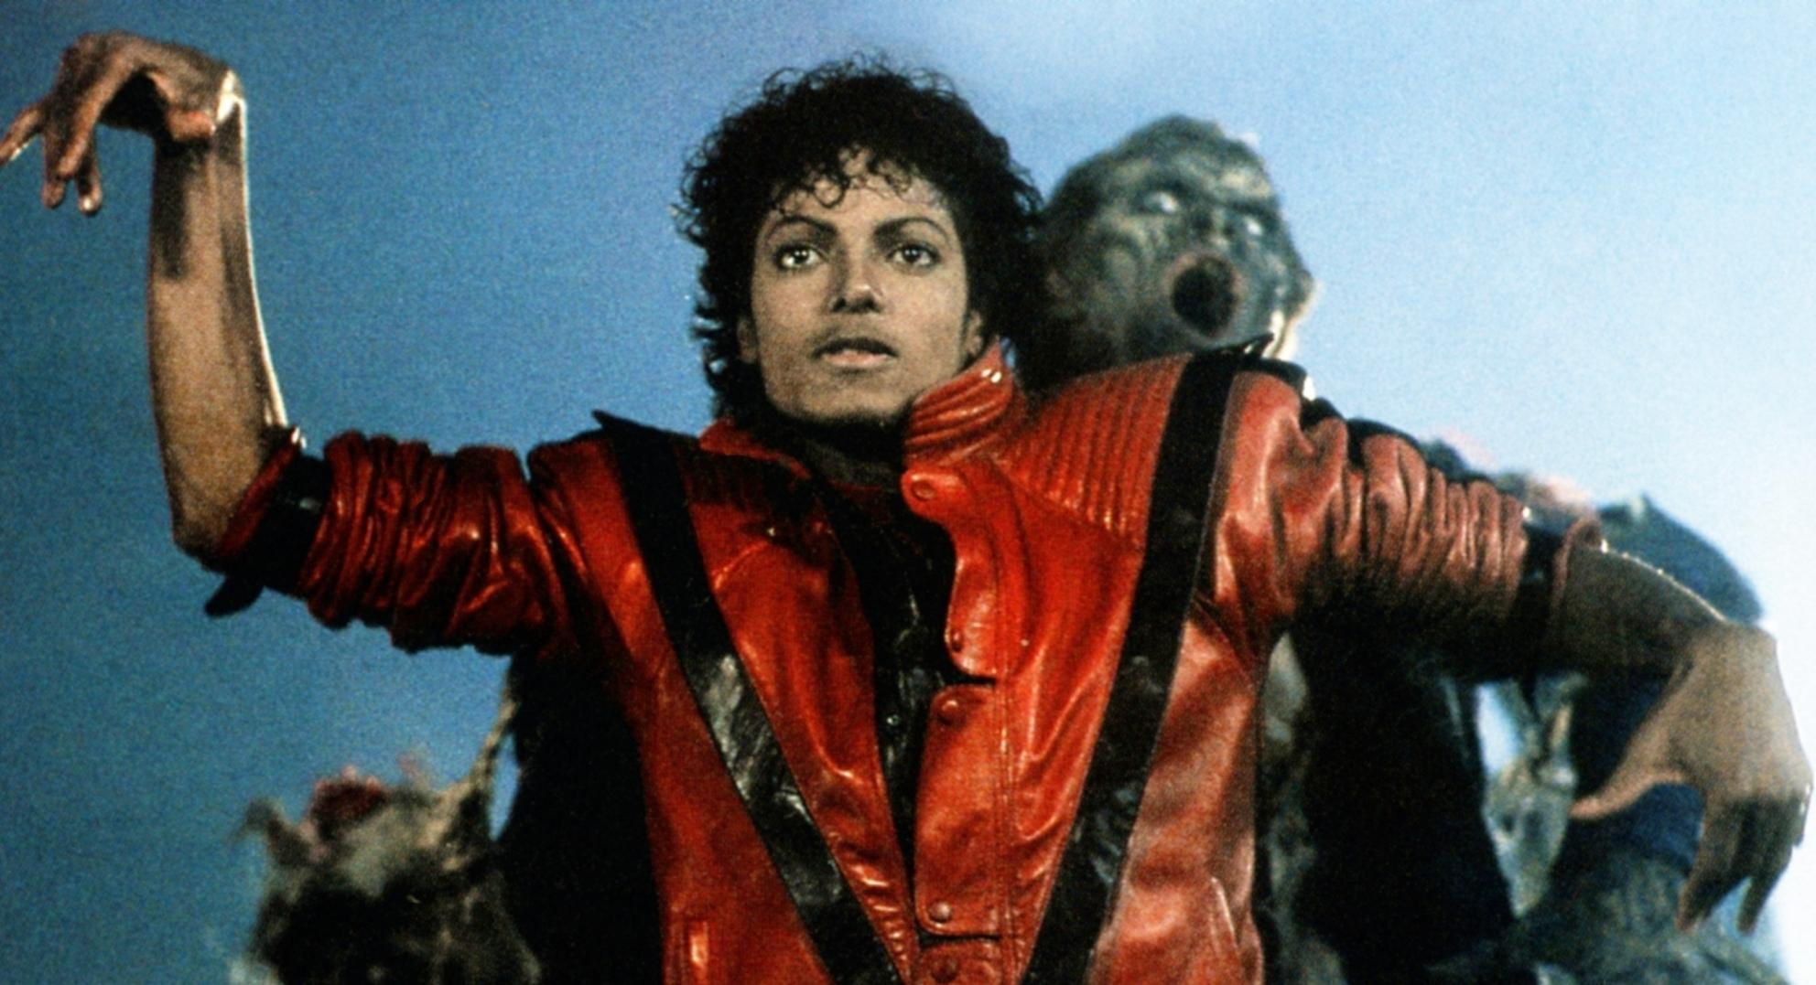
Bonus加分題:
Michael Jackson
【Thriller】

