Slide 1
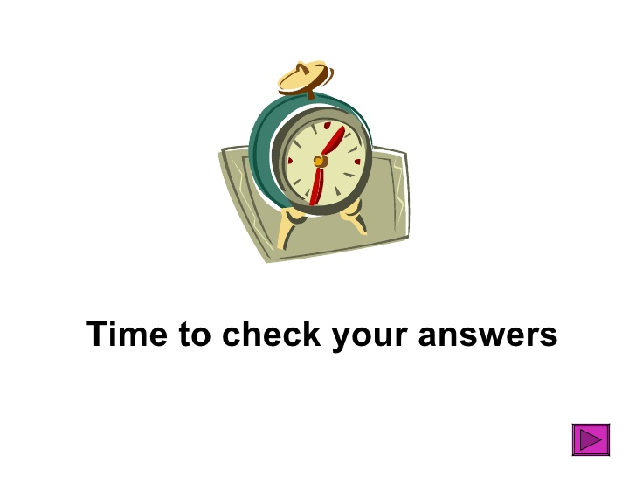
delight
anger
sorrow
happiness

Slide 3
What’s that? It’s Uluru, the biggest rock in the world. It changes its color when the sun rises. Wow! It’s amazing! Shh. We can’t yell here. We need to be quiet!

Slide 4
A: Hi! Chargoku. What do you want?
B: Sawadika! I want a Thai banana pancake.

Slide 5
A: Hey! Zenichu. What do you want after doing thunder breathing?
How about some papaya milk smoothie? B: Nope!
A: Some grape wine? B: Un-uh!
A: Some watermelon shaved ice? B: Sure thing!

Slide 6
A: Welcome to Taiwan, Shinofree. We have a lot of yummy food.
What do you want to eat? Let’s go to “通化” night market!
B: Yippee! I want to eat some stinky tofu and bubble milk tea.

Slide 7
A: Good morning, Squirjiro! Today, you have apple juice,
two tea eggs and one hot dog. It’s 80 dollars in total.
B: Keep the change. Hurry up! I’m so hungry.
I can’t want to eat them.

Slide 10
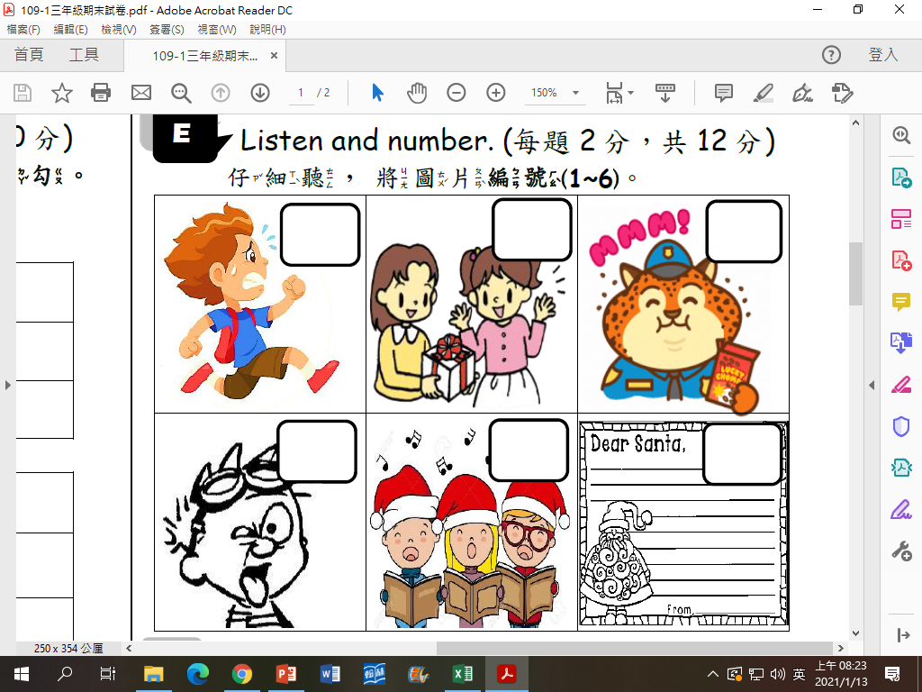
3
1
4
Hurry up!
Here you are.
Yummy!
2
6
5
Let’s sing a Christmas carol.
Let’s write a letter to Santa!
Yuck!

Slide 11
B
A: (Annoying style) Hey Mandy! Did you have fun at Tamsui Old Street? I see something in your bag. What are those?

Slide 12
A
A: Welcome to KFC! For here or to go?
B: Conceal, don’t feel. Order to gooooooo… Get food to gooooooo…
A: OK. Unh… Here you are.

Slide 14
p y m k
u p k
t m l
ea
g p

Slide 15
want
an

Slide 16
Do
don’t
Look
like
these
some

Slide 17
What are those?
No, I don’t.

Slide 18
I want some hot dogs.
只要文法沒錯就給分!
No, I don’t.
Yes, I do.

Slide 19
3
2.4

Slide 20
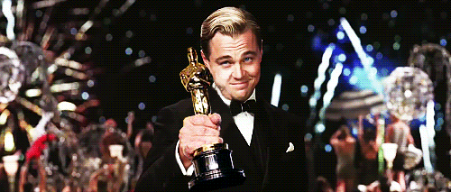
100~104: 5 stamps
90~99: 4 stamps
80~89: 3 stamps
70~79: 2 stamps
60~69: 1 stamps
比期中考進步10分以上:
多+ 1 stamp
進步20分以上:
多+ 2 stamp

Slide 21
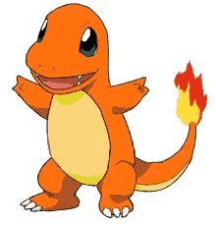
So far…
How many stamps you’ve got?

Slide 22
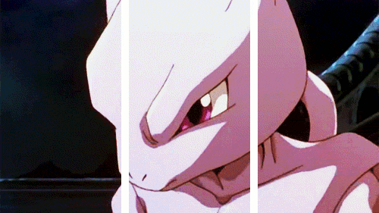
Mewtwo exchange!!!!

