Slide 1
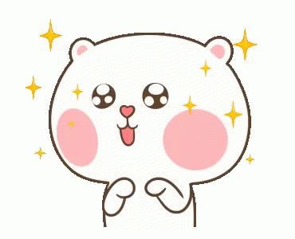
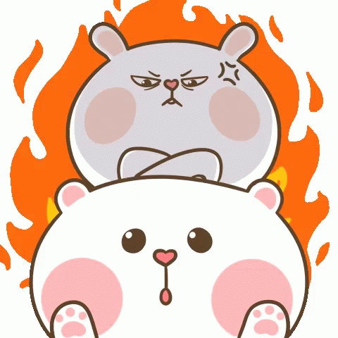
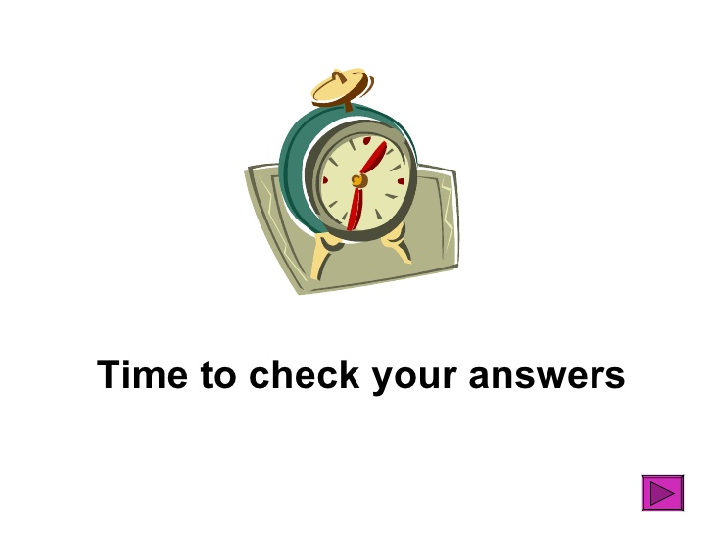
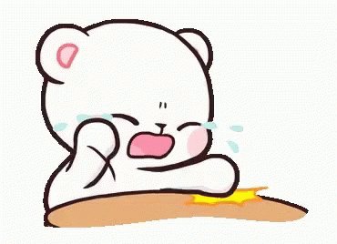
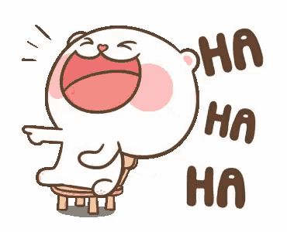
delight
anger
sorrow
happiness

Slide 3
Mandy! Don’t quit! Just sip some tea and yell “Arrrrr”. You might be happy again.

Slide 4
I am Iron man.
Who is he?
He’s my brother Tanjirou.
She’s sad because she can’t swim.
This is my friend, Chang-O.
Is Ke P a farmer?
No, he isn’t.

Slide 5
A: (sniffing) Mmm…Smells good!
Who’s cooking in the kitchen?
B: That’s my brother.
He’s an amazing cook.
Q: Is Mandy’s brother a doctor?

Slide 6
A: Hey, Pikachu. If you can do
something, you say “Pika”.
If you cannot do something,
you answer me “Pika Pika”. Got it?
B: Pikachu!
A: Can you jump? B: Pika!
B: Can you dance? B: Pika Pika…
A: Can you fly? B: Pika Pika……
Q: What can Pikachu do?

Slide 7
A: Hi, Tanjirou. Where’s your sister
Nezuko Chan?
B: She’s sleeping at home.
She’s dog- tired.
We went trick-or-treating last night.
Q: How is Nezuko?

Slide 8
(Banana song)
A: Wow! The Minions are so cute!
B: Yeah. When they’re happy,
they can sing Banana song.
Q: Are Minions happy?

Slide 9
5
6
2
Happy Moon Festival.
Of course!
Happy Halloween.
4
1
3
Help! Help!
Are you OK?
Watch out!

Slide 10
A: Happy birthday to Mandy. Happy birthday to you.
B: Thank you! Wish me happy 18th birthday.
A: Happy…Wait! You said so last year. Come on!
You’re already thirty something years old. Maybe 31, 32…
B: Silence! From now on. I would be 18 years old every year.

Slide 11
A: (coughing seriously)
B: (screaming) You got Covid-19.
A: No, I’m just sick. OK?
Besides, I wear a facial mask all the time.
B: Sorry...Hope you get well soon.

Slide 12
A+B: (Singing) Tale as old as time. Song as old as rhyme.
Beauty and the Beast.
A: I love the movie “Beauty and the Beast”.
B: I remember the scene that they danced with each other.
A: Yes! So romantic!

Slide 13
A: Hi, I’m Joy. Today is mid-term exam.
I’m like over the moon. I will get 100 points!
B: I’m Anger. Exam makes me want to hit the ceiling. Arrrrrr.
A: Anger! Stop! Deep breath!
B: I don’t want to stop! You stop! Arrrrrrr.

Slide 14
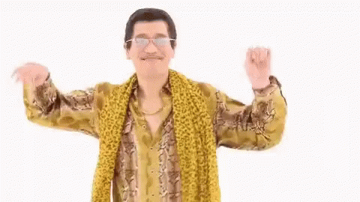
I have a pencil. I have a paper.
(Huh) Midterm Exam!
You’re gonna writing, writing, writing. (*4)
Watch the time. Finish the test. Try your best.
Check your answers twice and carefully.

Slide 16
a g y
un
th s
ea
ra

Slide 17
can
sing

Slide 18
Is
isn’t
That’s
meet
Are
am

Slide 19
Can you swim?
No, I can’t.

Slide 20
只要文法沒錯就給分!

Slide 21
sad
happy

Slide 22
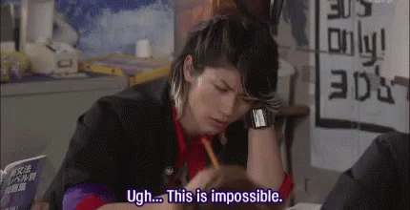
Making corrections is very important!

