Slide 1
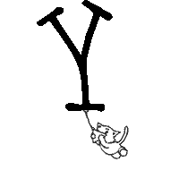
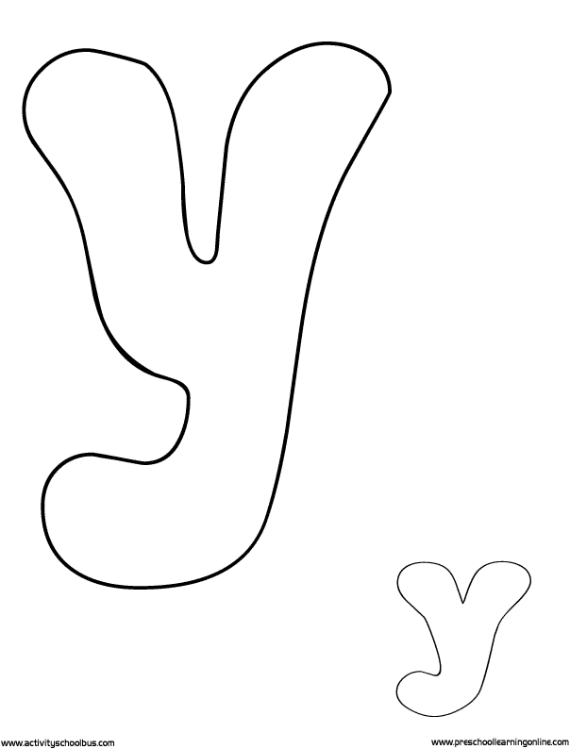
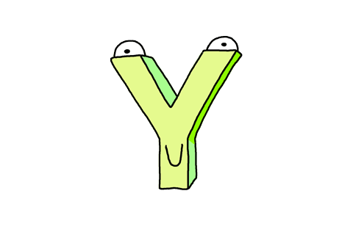

Slide 2
Get 10 stamps
Choose 1 thing from Evolution Zone(進化區).
Choose 2 things from Movement Zone(招式區).
Choose what( ) you want.

Slide 7
“y”:
“I” :
”i”:

Slide 8
y在字首，直接讀letter sound “y”.
y在字尾，且單字只有一音節，讀 “I”
y在字尾，且單字有兩個音節，讀”i”

Slide 9
