Slide 1
Let’s calculate the points of homework in this semester!

Slide 2
習作: 寫下6個頁數的分數+6頁出現的百變怪(含筆記頁)、上下兩張貼紙共12個分數，請算出平均分數後寫上(小數點第一位四捨五入，例: 94.5→ 95 / 91.2→ 91)
Be smart: 用1200-(所有被扣的分數)會比較快
作業簿: 寫出6個成績+百變怪總數、算出6個成績的總平均(也是小數點第一位四捨五入)
考試本:寫出4個成績+百變怪總數、算出6個成績的總平均(也是小數點第一位四捨五入)

Slide 3
How many Dittos stamps you can get?
所有百變怪總數除以5
跟Mandy回報幾餘幾

Slide 4
Let’s check out your test paper!

Slide 5
Abby
Adam
Josh
Mandy
Bruce

Slide 6
〇
X
X

Slide 7
V
V

Slide 8
V

Slide 9
V
V
V
V

Slide 10
V

Slide 11
department store
palyed on-line games
ponytail

Slide 12
V
V
V
V
V
V
V
V

Slide 13
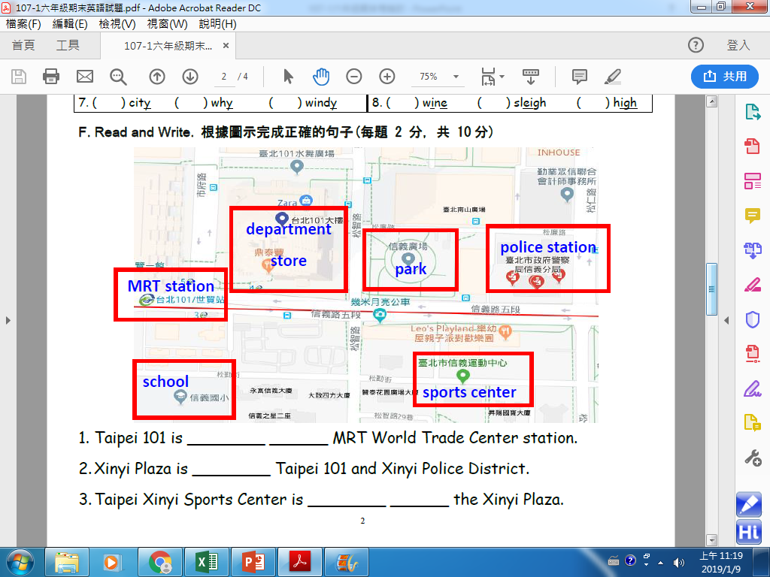
next
to
between
across
from

Slide 14
D
C
B
D

Slide 16
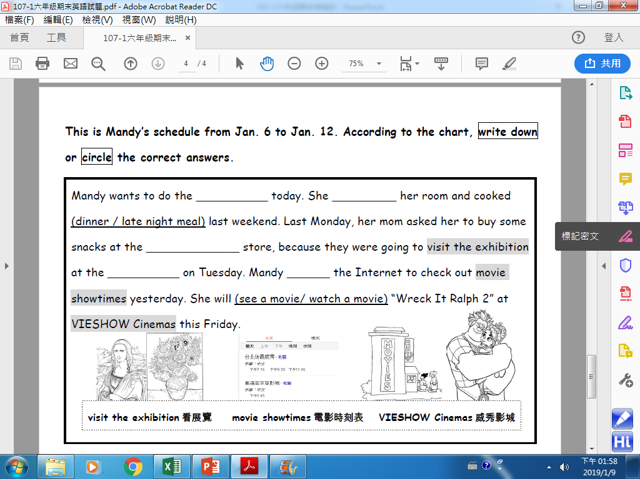
laundry
cleaned
convenience
museum
surfed

Slide 18
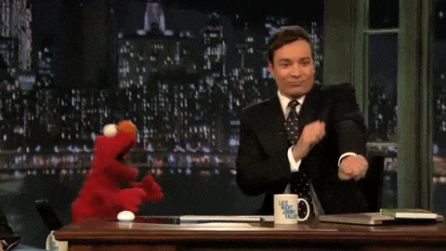
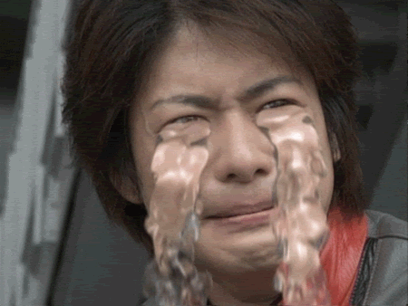
It’s not the end, it’s the beginning!

