Slide 1
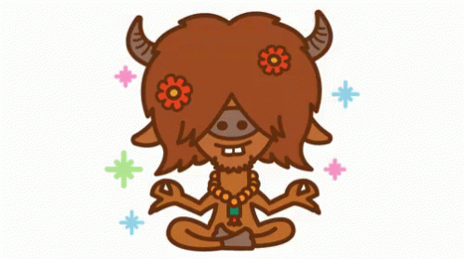
105-2 Midterm Multiple Assessment

Slide 2
Q1: Which one is correct?
twelve
twenty
(B) twenty
twelve

Slide 3
Q2: Which one is correct?
forty
fourteen
(B) fourteen
forty

Slide 4
Q3: What can he do?
He can dance and write.
(B) He can sing and draw.

Slide 5
Q4: What time is it?
It’s nine.
(B) It’s twelve oh nine.
(C) It’s twelve forty-five.

Slide 6
Q5: What time is it?
It’s two oh six.
(B) It’s six thirteen.
(C) It’s two thirty.

Slide 7
Q6: What time is it?
It’s eleven forty-five.
(B) It’s eleven
fifty-five.
(C) It’s eleven
fifteen.

Slide 8
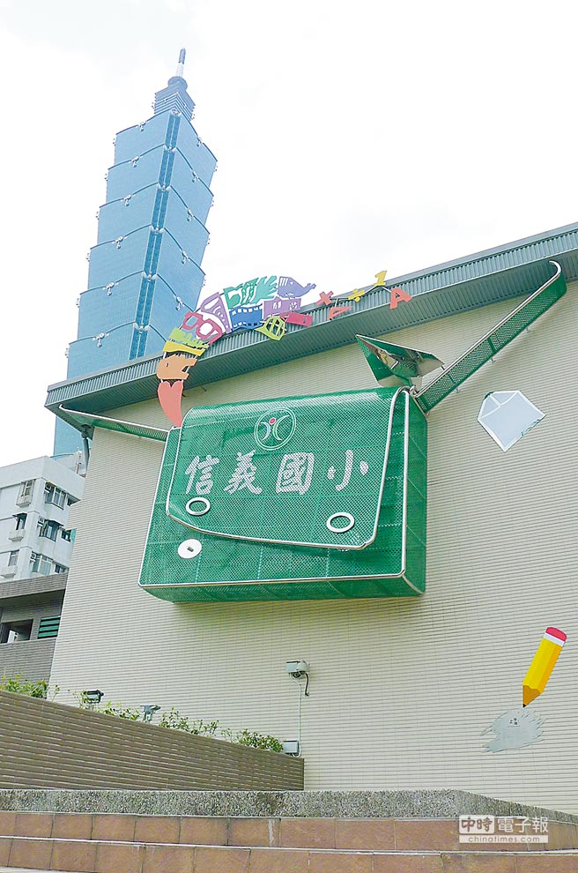
Q7: It’s seven forty.(AM)
Time for TV.
(B) Time for bed.
(C) Time for school.

Slide 9
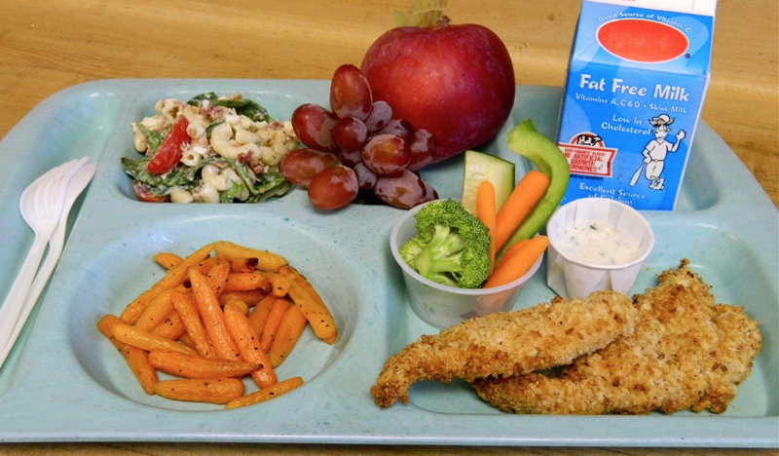
Q8: It’s twelve o’clock.(PM)
Time for dinner.
(B) Time for lunch.
(C) Time for breakfast.

Slide 10
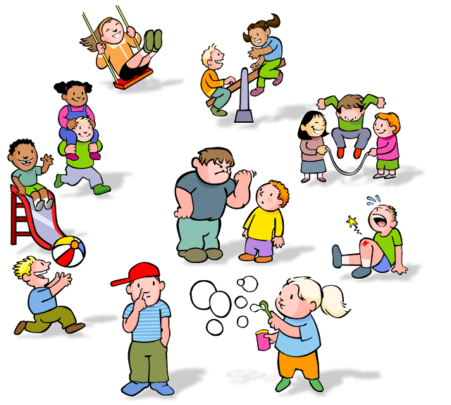
Q9: It’s ten ten.(AM)
Time for recess.
(B) Time for homework.
(C) Time for shower.

Slide 11
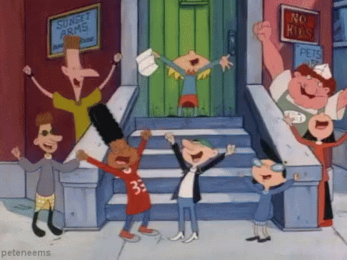
Q10: Which one is correct?
Yummy!
(B) Hooray!
(C) Let’s go!

Slide 12
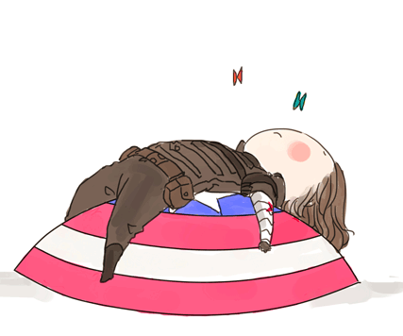
Q11: Which one is correct?
Hurry up!
(B) Time for lunch.
(C) Take a rest.

Slide 13
Q12: Which one is correct?
Come and join us.
(B) Come here.
(C) Come back home.

Slide 14
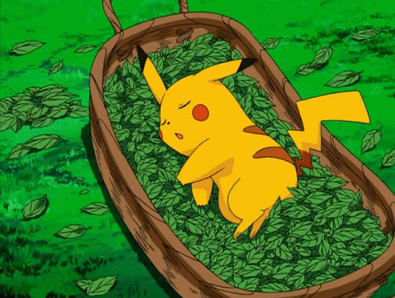
Q13: What is it doing?
It’s eating.
(B) It’s sleeping.
(C) It can sleep.

Slide 15
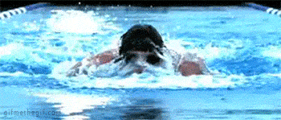
Q14: What is he doing?
He’s swim.
(B) He’s swiming.
(C) He’s swimming.

Slide 16
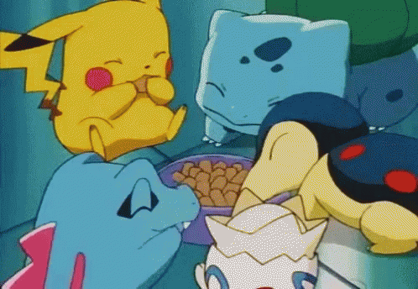
Q15: What are they doing?
They is eating.
(B) They’re eating.
(C) They’re eatting.

Slide 17
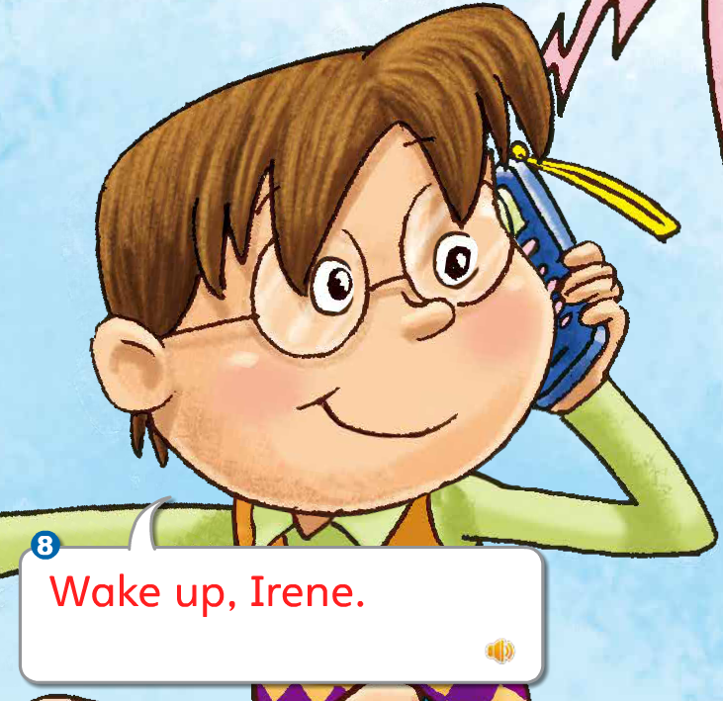
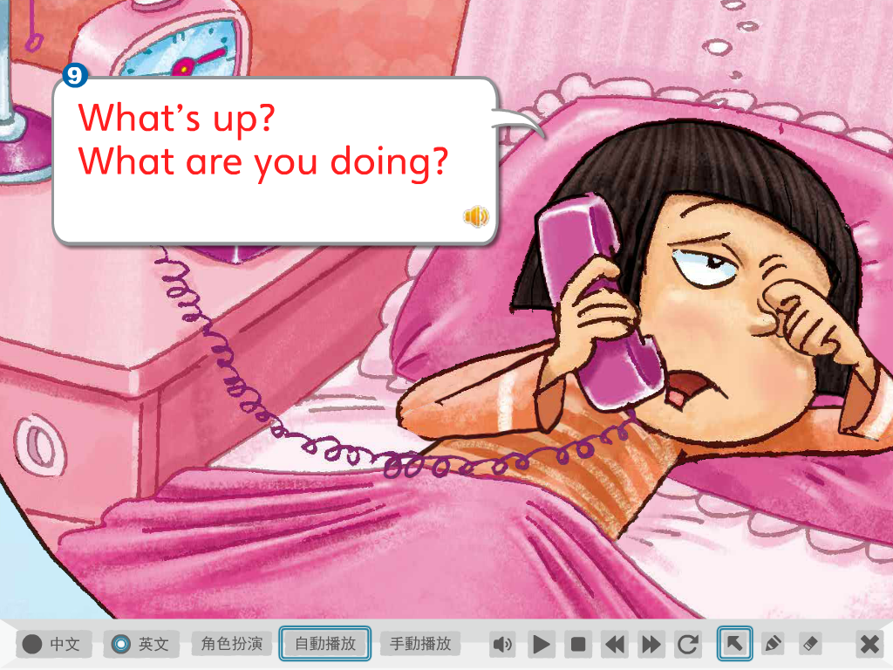
Q16:
Wake up.
What’s up?
(B) Wake up.
Come join us.
(C) Wake up.
Take a rest.

Slide 18
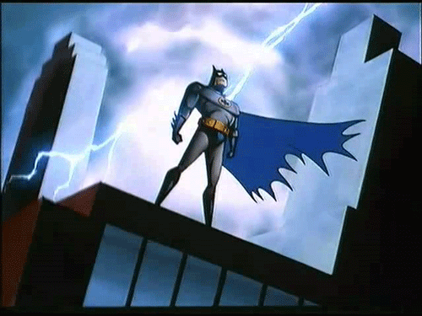
Q17: Listen and choose.
a / a_e.
(B) e / e_e.
(C) i / i_e.

Slide 19
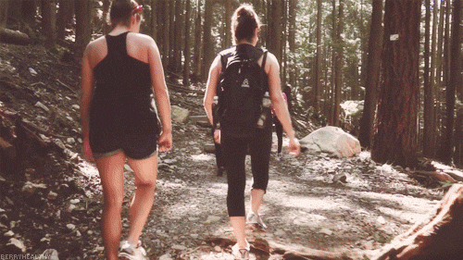
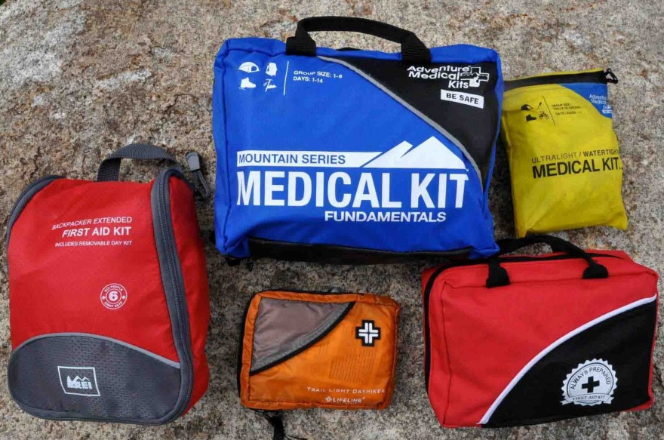
Q18: Listen and choose.
a_e / a.
(B) e_e / e.
(C) i_e / i.

Slide 20
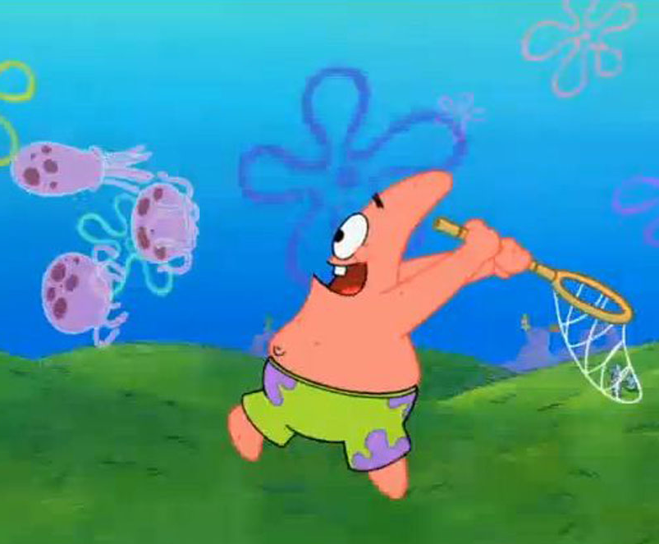
Q19: Listen and choose.
a / a_e.
(B) e / e_e.
(C) i / i_e.

Slide 21
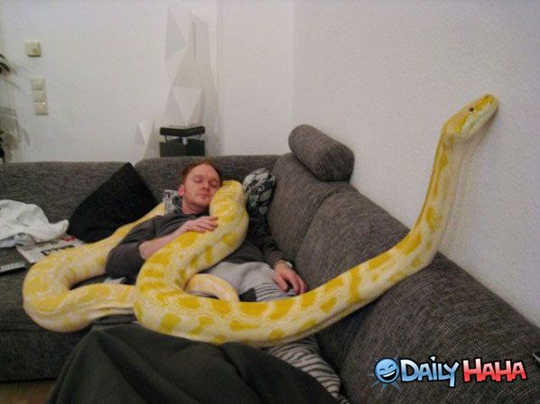
Q20: Listen and choose.
a / i_e.
(B) e / a_e.
(C) i / e_e.

Slide 22
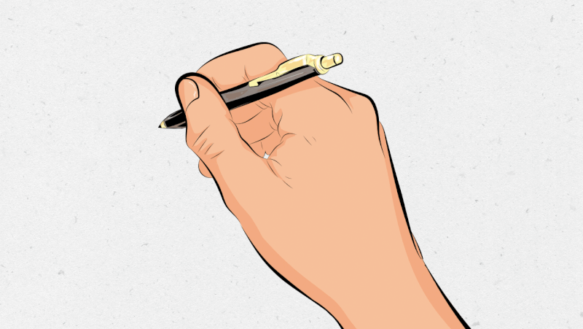
Q21: Make a sentence.
I
write.

Slide 23
Q22: Make a sentence.
You
run.

Slide 24
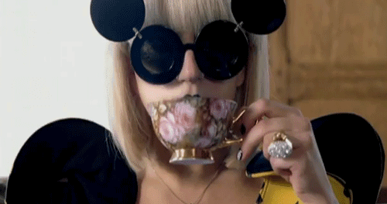
Q23: Make a sentence.
She
drink.

Slide 25
Q24: Make a sentence.
They
sing.

Slide 26
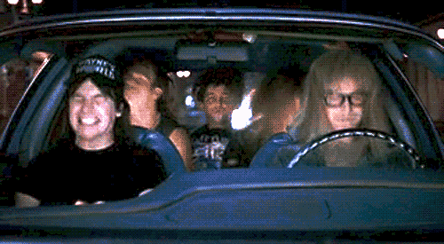
Q25: Make a sentence.
We
sit and drive.

Slide 27
It’s your show time!!!

Slide 28
This is a cape.
That is a hat.
I like the cape.
I hate the hat.

Slide 29
He is Pete.
Pete has a pet.
She is Eve.
Eve has a net.
Pete and Eve can speak Chinese of pet and net.

Slide 30
Hike with a kit.
Ride with a kite.
Let’s hike and ride a bike.

Slide 31
One Direction-One Thing

Slide 32
Pokémon Theme Song

